Slide 1
Social Work in Medical Setting
Service Setting Briefing for Summer Block Placement 2026

Slide 2
Rundown
Mutual Introduction
Where are you posted?
SWD or HA, why matters? (5 mins discussion)
Protect yourself and others
Overview of Social Work Services in Hong Kong Health Care
Exercise (10 mins )
How to prepare yourself for this placement?
Final reminder: ethical principle (Privacy and Confidentiality)
Infection control training and Orientation visits
Mid-Placement Sharing
Helpful resources
Q & A (5 mins)

Slide 3
Summer Block 2026
QEH, AMC x 2
KH, MSSU x 1
WTSH, MSSU x 1
POH, PRC x 3
TSWH, PRC x 1
QMH, PRC x 2
CMC, MSSU & HRC x 2
HKU-QMH, CARE x1

Slide 4
Summer Block 2026
YFSMC, MSSU (Psy. D) x 2
PYNEH, MSSU (Psy.D) x 2
KCH, MSSU (Psy.D) x 2
PMH, MSSU x 2
NLH, MSSU x1

Slide 5

Where are you posted?

Slide 6
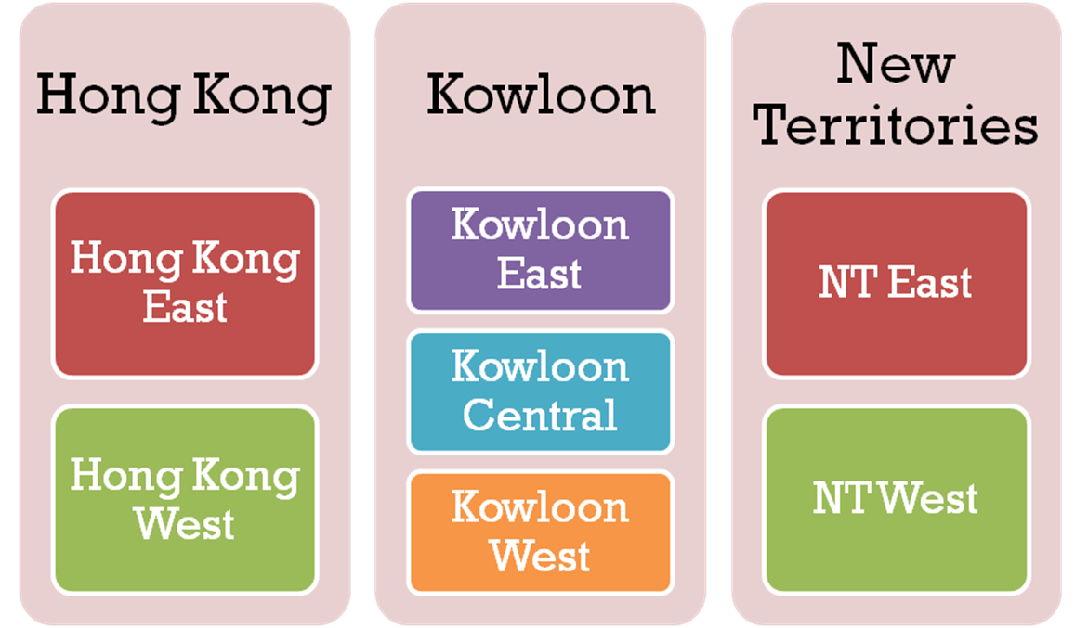
HA Clustering
Hong Kong
Hong Kong Island
Kowloon
Kowloon
East
Kowloon Central
New Territories
NT East
NT West
Kowloon
West
Hospital Authority : Clusters, Hospitals & Institutions
https://www.ha.org.hk/visitor/ha_visitor_text_index.asp?Content_ID=10122&Lang=ENG&Dimension=100&Parent_ID=10121&Ver=TEXT
Notes:
The Hospital Authority manages 43 public hospitals and institutions, 49 Specialist Out-patient Clinics and 75 Family Medicine Clinics. These are organised into six hospital clusters based on locations.
a continuum of high quality care within the same geographical setting and throughout their episode of illness – from acute phase through convalescence, rehabilitation, and community after-care.
HKI: QMH, PYNEH. KLN Central: QEH, KH, WTSH. KLN E: YFS/ UCH. KLN. W: CMC, KCH, PMH, NLH

Slide 7
Hong Kong Island Cluster
(effective from 1 April 2026)
4 acute hospitals: QMH, PYNEH, Ruttonjee Hospital, and St John Hospital - along with 10 rehabilitation, convalescent and extended care hospitals and 18 Family Medicine Clinics, primarily serving around 1.2 million residents on Hong Kong Island.
"localising where possible, centralising where necessary"
https://www.ha.org.hk/HAConnect/en/WhatIsNew/Details/1706?fontsize=medium

Slide 8
SWD, HA, Why matters?
Discussion: 5 mins
Social workers’ employment
Target group
Services provision
Relationship with the inter-disciplinary team

Slide 9
SWD, HA, Why matters?
All PRC, CPRC, HRC and specialized project like AMC are under HA
All MSSU (Psy.D) are under SWD
Post rotation of SWD
Ward rounds/ case conferences
Primarily focus on casework of MSSU under SWD
Statutory functions of SWD workers
Medical assistance and waiving

Slide 10
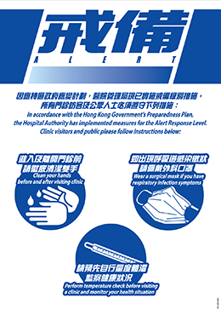
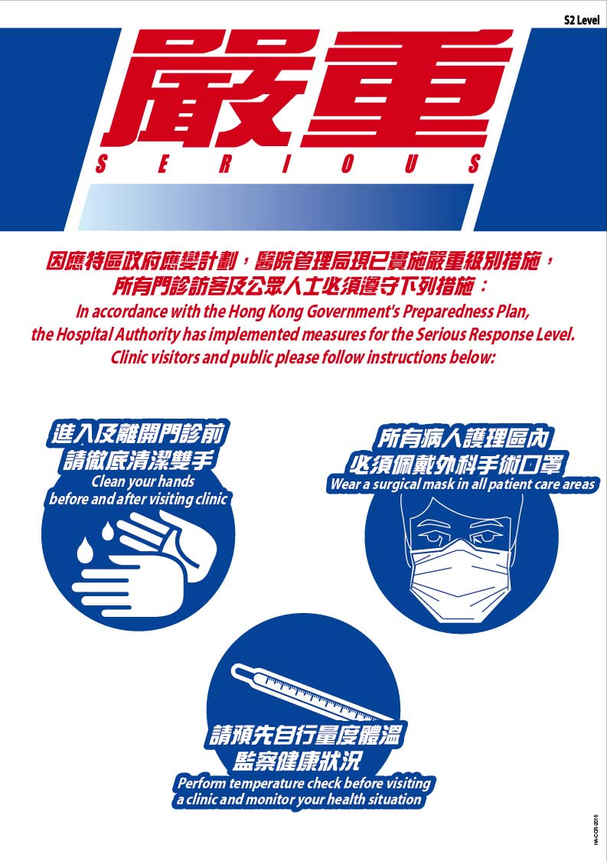
Infection prevention measures: Protect yourself and others

Slide 11

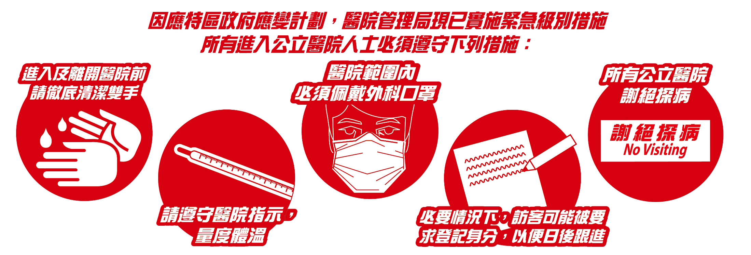
Infection prevention measures: Protect yourself and others

Slide 12
HA Strategic Plan 2022-2027
Enhance sustainability by changing our service models towards “Smart Care”……

Slide 13
Provide Smart care: Adopting new service models and technology to improve health outcomes and reduce the need for our patient's hospital care.
Develop Smart Hospitals: Using Information technology (IT), digital technology and Artificial Intelligence (AI) infrastructure to enable Smart care and enhance operational efficiency.
Nurture Smart Workforce: Nurturing a robust and flexible talent pool with the skills and knowledge for providing Smart Care.
Enhance Service Supply: Expanding and modernizing facilities and ensuring financial sustainability to meet escalating service needs.

Slide 14
HAGO
https://www.facebook.com/ha.hospitalauthority/videos/ha-go%E6%9C%89%E4%B9%9C%E5%8A%9F%E8%83%BD/740971916660716/

Slide 15

Public health care fees and charges reform
Public healthcare fees and charges reform effective from 1 January 2026
Background, rationale and major change P2025032500394_490027_1_1742898124325.pdf
Means Test Calculators available on the Medical Fee Waiving and Samaritan Fund
* Samaritan Fund has to be referred by doctors or allied health professionals

Slide 16
Enhance medical fee waiving – extend coverage scope and validity period
https://youtu.be/2vs6xYdh1Do

Slide 17
New Acute Hospital
New Acute Hospital at Kai Tak Development Area
Most of the clinical services of QEH will be relocated to the NAH in phases starting from the 2026, with Specialist Out-patient Clinic Block and Oncology Block being the first to move in and commence services.
Upon completion, the NAH will be one of the largest acute hospitals in Hong Kong, with a total gross floor area of 500,000 square metres with 2400 beds, 37 operating theatres and a wide range of clinical services and facilities

Slide 18
Mandatory Reporting of Child Abuse Ordinance come into effect on January 20, 2026.
Child protection online training
https://www.childprotectiontraining.hk/

Slide 19



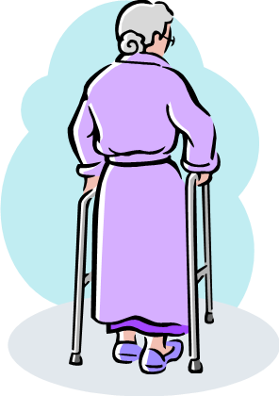


Expectations of others towards social workers in the medical setting

Slide 20
Role and Functions of MSWs
Psycho-social assessment
Counseling/therapy, crisis intervention to individuals & their families
Educational, self-help & therapeutic groups
Pre-admission planning
Discharge planning
Practical assistance
Multi-disciplinary teamwork
Empirical research
Mobilizing community resources

Slide 21




In-patient vs out-patient services support

Slide 22
Scope of Services of PRC
Empowerment and support for patients and carers
New patient orientation
Psychosocial service
Sharing by patient volunteer
Stress management workshop
Therapeutic group
Mutual support network
Patient association forum
Patient association Training
Patient support station
Peer concern service

Slide 23
Scope of Services of PRC
Volunteer service and development
Volunteer service development and mobilization
Volunteer Training and quality management
Volunteer management system
Community engagement and partnership
Community health project
Medical Social Collaboration via Platforms, Referral Mechanism, Collaborative projects, Symposium
Community Resources Navigation

Slide 24
Scope of Services of PRC
Rehab resources
Health Information and Healthyhkec website
Mobility Equipment Loan (By Hong Kong Red Cross)
Rehab Shop service
Wig Loan service for Cancer patients

Slide 25
Cancer Patient Resources Centre
Cancer information libraries
Computer stations
Professional counselling services
Relaxation rooms and massage chairs
Rehabilitation workshops
Meeting rooms for peer-support activities

Slide 26
Palliative care services
Palliative care service aims to provide holistic care to patients with life-threatening and life-limiting conditions and their families to address their physical, psychological, social and spiritual needs.
It is provided through a multidisciplinary team of professionals, including doctors, nurses, medical social workers, clinical psychologists, physiotherapists, occupational therapists, etc to improve the quality of care and facilitate a more peaceful dying process with a comprehensive service model.
Online free course on end-of-life care by JCECC
https://foss.hku.hk/jcecc/online/Basic_Module/course_intro

Slide 27
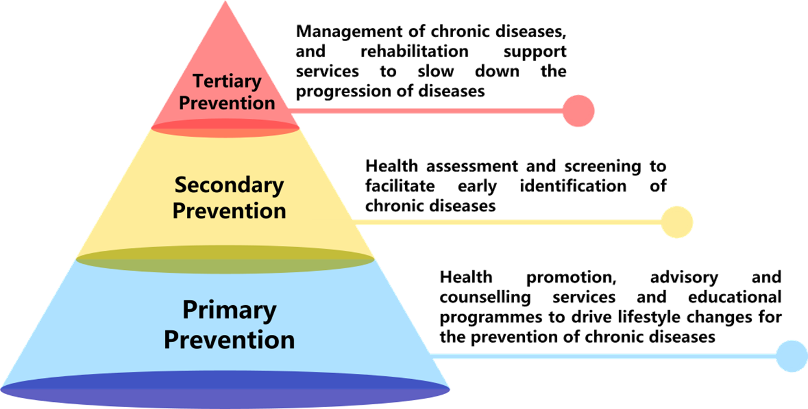
Primary Care

Slide 28
Scope of Services of DHC
Health Promotion (Healthy Diet, Physical Activity, Weight Management, Fall Prevention, Smoking Cessation, Alcohol Consumption, Sleep Hygiene, Mental Well-being)
Health Assessment (Health Risk Factors Assessment screening for Diabetes Mellitus/Hypertension)
Chronic Disease Management (Diabetes Mellitus Hypertension, Musculoskeletal Disorder, Low back pain, or Degenerative knee pain)
Community Rehabilitation (Hip Fracture, Post-Acute Myocardial Infarction Stroke)

Slide 29

Exercise

Slide 30
C.R.1
27/6/2020
Pt’s e. dtr. S.I.O.
CMO referred Pt for soc. Ax., DA, and Dis. Planning. W/M sent Pt’s dtr to see MSW. A brief Soc. Ix was done
Med. Hx of Pt
Pt: with chronic Schiz., c irregular F/U & poor drug compliance, ADL ok., Aud. Ho++. Had a T/A on 20/6/2020 (crossed a road neglecting the red light as a voice told her to). Admitted to Ortho c multiple #, ® b/k Amp and POP to # (L) N/femur
Soc. Background
Hd Retired x 10 yrs. due to Ca Colon, c colostomy and RT, on remission. Had CVR ® with aphasia 4 wks ago, presently convalescing at SH, w/c bound, undergoing active OT & PT, just started walking with frame for a few steps
E. Dtr: Married & L/A, a HW c a 6-yr-old dtr; living with m-i-l, who had a Dx of CRF & just started CAPD, and f-i-l, who had HT, DM, CHF but ADL independent
2nd Dtr Married & L/A, a HW c 2 sons (2; 6 mths resp.) E. son was suspected to have delayed development, recently referred by GP to CAC for Ax. Appt. scheduled in 11/2020

Slide 31
27/6/2018
Patient’s elder daughter Seen-in-office
Case medical officer referred patient for social assessment, Disability Allowance, and discharge planning. Ward manager sent patient’s daughter to see medical social worker. A brief social investigation was done
Medical history of patient
Aged 55, Diagnosed with chronic schizophrenia, irregular follow up and poor drug compliance, Activity of Daily Living Ok, Auditory Hallucination (very positive). Had a traffic accident on 20/7/2017 (crossed a road following a voice’s command during red light). Admitted to Orthopedic with right below knee amputation and Pin and Plate to fractured left neck of femur

Slide 32
Social Background
Husband: Retired for 10 years due to Carcinoma of Colon, with colostomy and radiotherapy, on remission. Had cerebral vascular accident (right) with aphasia 4 weeks ago, presently convalescing at Shatin Hospital, wheelchair bound, undergoing active occupational therapy and physiotherapy, just started walking with frame for a few steps
Elder daughter: Married and living apart, a housewife with a 6-year-old daughter; living with mother-in-law, who had a diagnosis of chronic renal failure and just started continuous ambulatory peritoneal dialysis, and father-in-law, who had hypertension, diabetes mellitus, congestive heart failure but activity of daily living independent
Younger daughter: Married and living apart, a housewife with 2 sons (2; 6 months respectively). Elder son was suspected to have delayed development, recently referred by general practitioner to Child Assessment Centre for assessment. Appointment scheduled in 11/2018

Slide 33
How to prepare yourself for this placement?
Knowledge (services trend and policy, new development in HA, specific hospital, resources)
Psychological (attitude, relationship, communication, handling cases, group, program, ethical principles)
Time management
Self-care and support

Slide 34
Attitude
Initiative
Humble
Open
Honest
Considerate
Flexible

Slide 35
Relationship
Aware of the work dynamics of the social work team
Aware of the rules and norms of collaborating with the interdisciplinary team
Mature in presentation
Accuracy in Reporting
Teamwork
Responsible and accountable

Slide 36
Communication
Written
E-mail, correspondence, formal letter to outside bodies (e.g., cooperating social work agencies, other units in the clinic/hospital)
Verbal
Take the initiative to clarify the appropriate means of communication with different persons (e-mail? Face-to-face? Phone call?) * WhatsApp is not a formal communication channel

Slide 37
Handling cases
Familiar with medical terms and abbreviations
Familiar with community resources (elderly long-term care, rehabilitation services, and social security)
Understand the constraints, routines, and rules in the ward
Beware the patient’s physical condition while interviewing
Infection control measures
Usually not encouraged after office hour interview or home visit
Be ready to seek help for triggered emotion, facing life and death issues, risks and crisis

Slide 38
Preparation for group and program
Timeline
Managing the financial matter
Promotional tips
Enrolment forms and handling of applicants’ data
Screening and evaluation
Theme and approaches

Slide 39
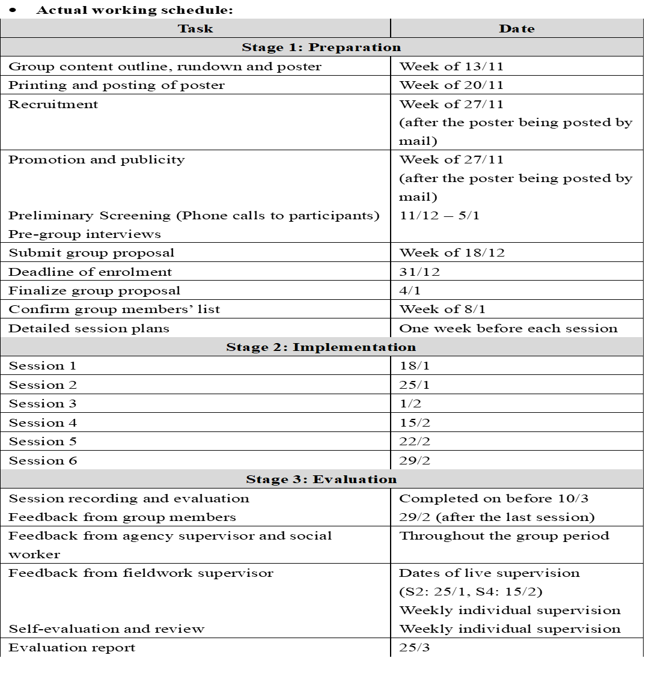

Slide 40
Some examples of groups
相說—自癒攝影小組
Joy種心靈綠洲小組
「幸福我有Say」身心靈自癒小組
GRACE Volunteer Training Group
乘風行
Art Jamming 放鬆心情工作坊
快樂腦有記

Slide 41
Administrative
Format and submission of recordings
Application of leaves
Reporting
Status of placement students
Dress codes and attire: smart casual, no sexy, no exaggerated clothing, hair colour or make-up.

Slide 42
Final reminder
Nature of workload
PRC : Mostly Group/ Program/ Project
MSSU (SWD/HA): Mostly cases
AMC/CARE: Case/Group/Program
DHC: Mostly group/program
Prior Approval
To get prior approval from FSWs and Agencies for all the work
Alert and Prompt Reporting
If encounter with any suspected child abuse situations in cases, groups, programs, or social encounters, students must follow the stated procedure guidelines and inform their mentor/IC and FWS immediately for follow-up action.

Slide 43
Final reminder: ethical principle (Privacy and Confidentiality)
1 .星島日報 | 2026-04-08 報章 | A08 |港聞
「靚仔醫生」違守則炒魷 九西聯網交醫委會跟進
ViuTV節目《全民造星III》參賽者、被稱為「靚仔醫生」的蘇浚祈，上月底捲入社交平台洩露病人私隱風波，醫管局前日回應《星島》查詢時表示，早前已嚴肅調查及全面檢視事件，涉事人員現非醫院管理局員工。九龍西醫院聯網昨發表聲明指，已與當事人終止合約，會將個案轉交醫務委員會跟進。 九龍西醫院聯網昨發表聲明指，已完成事件調查，確認該員工違反員工守則，已經與當事人終止合約，並將按機制將有關個案轉交醫務委員會跟進。 要求員工恪守保障病人權益 九龍西醫院聯網表示，作為公共醫療服務的提供者，聯網要求所有員工嚴守專業守則，保持誠信，並恪守保障病人權益與私隱的宗旨。對於涉嫌違規的個案，聯網務必嚴肅跟進。九龍西醫院聯網確認該員工有違誠信，行為亦嚴重影響醫生專業形象。 根據《醫院管理局附例》，任何人未經醫院內病人同意，不得在公營醫院內拍攝照片或影片或把醫院病房勾劃出來，保障病人私隱。 有網民上月底公開一則截圖，一個名為「sojendr」的IG帳戶，於限時動態發布一張在仁濟醫院急症室急救房中搶救病人的照片，寫有「久久一遇的Cardioversion（心臟復律） 全部入晒來睇我電人」字句，圖中有疑似醫護人員正圍着正接受搶救的病人。該截圖在網上引起熱議，因在網上發布急症室救人時的相片，可能違反醫院規定，亦不符醫生專業操守。 #### ■「靚仔醫生」蘇浚祈已被終止合約，其個案會交由醫務委員會跟進。

Slide 44
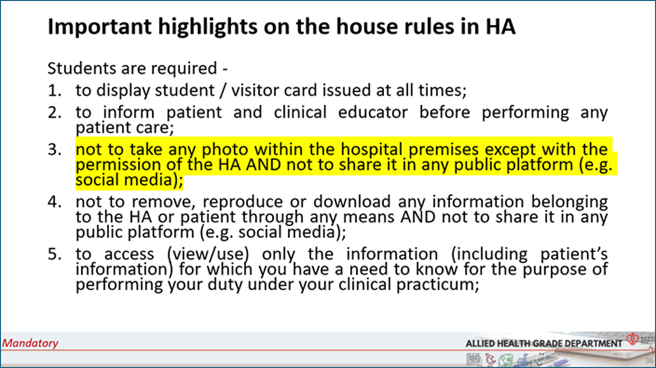

Slide 45
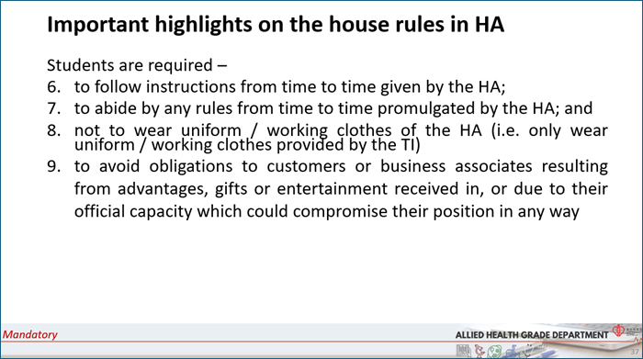

Slide 46

Importance on Data Protection
Stringent record-keeping standards and safeguarding confidentiality are not just responses to legal requirements; they are essential to competent and ethical practice in social work.

Slide 47
Guidelines on Data Protection
Familiarize yourself with and strictly comply with the
  Personal Data (Privacy) Ordinance (pcpd.org.hk)
  A-05 Record Keeping
  Agency policies on Data Protection.

Slide 48
Guidelines on Data Protection
Anonymize your recordings/reports for discussion with the fieldwork supervisor (e.g., Madam C..). They must not contain any identifying data. Names of persons, places, organizations, etc., should be removed.
The record files should be stored in designated password-protected electronic storage devices
All the reports/documents must be password-protected before sending to your fieldwork supervisor
Do not leave personal data and confidential information ( e.g. case files ) unattended
Never take clients’ personal data out of office unless there is a genuine operational need and must seek prior approval from the centre in charge
A-05 Record Keeping: Guidelines for Students in Fieldwork Placement_2023
To (hku.hk)

Slide 49
Guidelines of Data Protection
Once the purpose of teaching, learning and assessment is served, the placement records/reports should be destroyed or erased. If the students wish to have a copy of a particular piece of their own work for their future reference, they must seek the approval of the agency and complete any procedures as required by the agency.
The students will sign a Form at the end of the placement declaring that they have handed in all the records containing personal data of service recipients to the agency and the fieldwork supervisor as required; and that they have deleted all such records from their computer disks/relative devices if applicable; and that they have obtained the approval of the parties concerned for any copies which they wish to retain for their own personal reference. The form is attached at the end of Form A-10a/ A-10a_updated.
A-05 Record Keeping: Guidelines for Students in Fieldwork Placement_2023
To (hku.hk)

Slide 50
Guidelines of Data Protection
Use work phone to contact clients and prohibited using personal mobile phones to contact clients for placement (students can apply for a phone card from the Department with the support of the fieldwork supervisor)
Prohibited passing your personal or fieldmate’s or colleagues’ mobile contact to service users
Photos of the service users, agencies and colleagues should only be taken for work purposes and with prior consent, using the agency device instead of a personal mobile phone.
Ensure safe keeping of the agency student worker card
A-05 Record Keeping: Guidelines for Students in Fieldwork Placement_2023
To (hku.hk)

Slide 51
Guidelines on the Use of Social Media
Prohibited disclosing any information of the service users, agency, colleagues, field-mate, fieldwork supervisors on any social media
Prohibited uploading/ posting any photos/ comments/ sharing about placement sites/ colleagues/ field-mate/ fieldwork supervisors/ clients on any social media
Maintain professional boundaries and should not add service users as friends on your Facebook account/WeChat/WhatsApp/Instagram/or any social networking media….

Slide 52
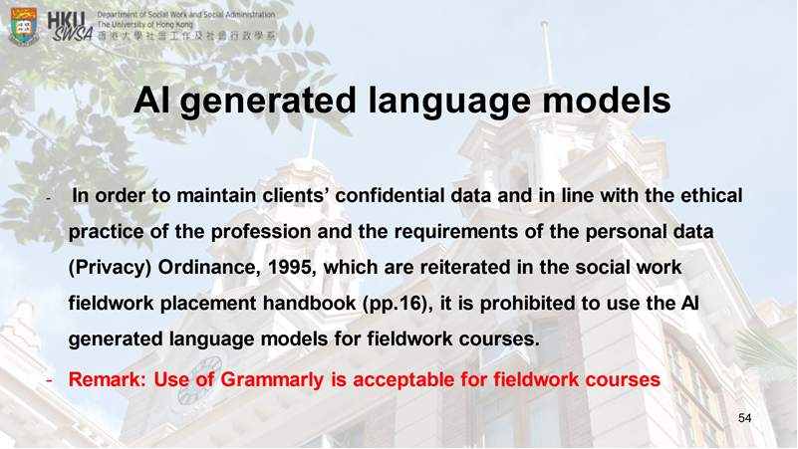

Slide 53
Orientation Program/Training
Infection control training of SWD students (7 May, Zoom) or arranged by the agency and informed via FWS
SWD Orientation for SWD MSSU students (8 May)
Compulsory Orientation Visit:
1. Tuen Mun Hospital (20 May pm)
Satellite centre and main centre of PRC, MSSU, Cancer PRC, Hospice Centre
2. 精神健康體驗館 Mind Space (4 June am)
Quota: 20. Please fill in the pre-visit survey that will be sent to you later.
All the above can count in placement hours
Please inform me if you cannot attend after gaining approval from your FWS
Details please refer to the email sent out earlier

Slide 54
Mid-phase Sharing (Compulsory)
A time for re-charging through
peer sharing and mutual support
3 July 2026
9:00-1:00 pm
CPD-532 @HKU

Slide 55
Helpful Resource
( full list in placement website resource corner, MSS List)
Smart Patient
https://www.smartpatient.ha.org.hk/en
HA Drug Formulary Management
https://www.ha.org.hk/hadf/en/index.html#gsc.tab=0
Smart Elders
https://www.smartpatient.ha.org.hk/en/smart-patient-web/theme-based-module/smart-elder/home
Community Services for Elderly
https://www.swd.gov.hk/en/pubsvc/elderly/cat_commcare/index.html
Residential Services for Elderly
https://www.elderlyinfo.swd.gov.hk/en/rches_natures.html
Community Care Service Voucher Scheme https://www.swd.gov.hk/en/pubsvc/elderly/cat_commcare/psccsv/#:~:text=Details%20of%20the%20Scheme&text=Elderly%20persons%20may%20choose%20any,are%20%2410%2C455%20and%20%244%2C372%20respectively
JCECC online free courses for end-of-life care
https://foss.hku.hk/jcecc/online/Basic_Module/course_intro

Slide 56

Good Luck & Carry On !!

