Slide 1
Placement Briefing : Rehabilitation Services
Monica Mok
Rehabilitation Service Setting Coordinator
Department of Social Work & Social Administration
22 Nov 2025

Slide 2
What comes to your mind when you hear….
REHABILITATION?

Slide 3
Major objectives of Hong Kong Rehabilitation Services
Community Integration
Lead as normal a life as possible
Strengths/potentials
Assist them in developing their physical, mental and social capabilities to the fullest possible extent
Person Oriented
- Acknowledge the equal rights
- Be full members of the community
- Contribute to society as much as they can

Slide 4
Estimated Number of Disabilities in 2023
Around 600,000 persons had one or more types of disability (physical, mental, intellectual, etc)
The overall prevalence rate of persons with disabilities was 8.1%

Slide 5
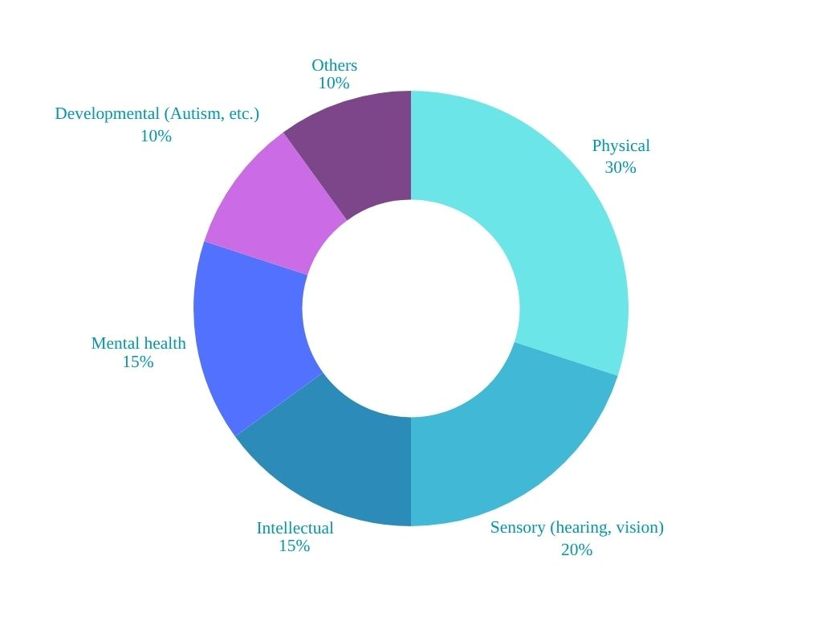
Estimated Number of Disabilities in 2023
Source: Census and Statistic Dept. 2023

Slide 6
Role of Social Workers in Rehabilitation services:
Assessment and Planning: to understand clients’ strengths, needs, and goals, develop recovery plans.
Advocacy and Support: Act as advocates for clients’ rights and opportunities
Holistic Care: Address not only medical or functional needs but also social, emotional, and environmental factors influencing clients’ well-being.
Interdisciplinary Collaboration: Work closely with professionals, families and community.
Empowerment and Capacity Building: Enabling clients to equip skills

Slide 7
Pre-school Rehabilitation Service (PRS)
Children with disabilities from age 0-6 who have not yet started primary school.
Placement service target: parents of children. Students may have opportunities to work with children.

Slide 8
Service
Early Education and Training Centre
Special Child Care Centre
Training Subsidy for Children who were on the Waiting List of Subvented Pre-school Rehabilitation Services’ (TSP) 2014
The Pilot Project on Tier 1 Support Services in Kindergartens/ Kindergarten-cum-Child Care Centres 2020
Parent Resource Centre
Majority of pre-school working hour is daytime. Some of them will offer Saturday morning or night service.

Slide 9

Day Services (RSD)
Target: People with Ex-mentally Ill, Intellectual Disability, or Physical Disability
Service:
Vocational Rehabilitation Services / Day Training
Day Activity Centre (DAC)
Sheltered Workshop (SW)
Integrated Vocational Rehabilitation Services Centre (IVRSC)

Slide 10

Day training or vocational rehabilitation service
Normal office working hour
Usually, five days work
No night shift.

Slide 11
Vocational rehabilitation services
Block Placement:
Stewards - Syner-bright Zone, Youth Outlook
(Youth mental Health service)
Concurrent Placement:
VTC - Shine Skills Centre (Pokfulam)
or other special school service

Slide 12

Residential service (RSR)
Physically Handicapped Persons
Persons with Intellectual defiits
Persons in Mental Recovery
Visually Impaired Persons
Emergency Placement
Professional Therapy Services
Bought Place Scheme (BPS) for Private Residential Care Homes for Persons with Disabilities (RCHDs)
Self-financing Hostel

Slide 13
Residential service
Shift duty,
Open on weekends.
Hostel
Halfway House
Supported Hostel (SHOS) for Persons in Mental Recovery
Long Stay Care Home
PT students

Slide 14
Community support service (CRN)
Target: Mental disabilities, people in mental recovery, visually impaired Persons, hearing impaired, parents of service users
Centre-based Services
Home-based Services
Other Support Services
Support to the Carers of Persons with Disabilities/Persons in Mental Recovery
Daytime duty
Usually, one night shift
Open on weekends occasionally

Slide 15

Centre-based Services (RSD)
District Support Centre for Persons with Disabilities
Community Rehabilitation Day Centre
Day Care Service for Persons with Severe Disabilities
Social and Recreational Centre for the Disabled
Integrated Community Centre for Mental Wellness
Parents / Relatives Resource Centre
Professional Support Team to Parents / Relatives Resource Centre
Rehabilitation and Training Centre for Visually Impaired Persons
Multi-service Centre for the Hearing Impaired
Support Centre for Persons with Autism
Daytime duty, Usually, one night shift
Open on weekends occasionally
PT students

Slide 16
Other Support Services
Community Rehabilitation Network
Community-based Support Projects for Persons with Disabilities and Their Families
Communication and Information Service for Visually Impaired Persons
Central Paramedical Support Service Unit (CPMS)
Central Psychological Support Service (CPSS)
Day Respite Service
Residential Respite Service
Agency-based Occupational Therapy Service
Mobile Van for Publicity Service on Mental Wellness
The Pilot Project on Integrated Community Rehabilitation Centre (ICRC)
Care support

Slide 17
Chronic Illnesses
The Hong Kong Society for Rehabilitation
-Community rehab
-Empower programme
-Carer support
-Self-help groups
Life adjustment and caring are some of the many problems facing persons with physical disabilities, persons with chronic illnesses and older people.
PT students
Daytime duty,
Usually, one or two nights shift
Occasionally work on weekends

Slide 18
Special Schools
For students with more severe or multiple disabilities to aided special schools for intensive support services. Schools strive to:
-to help students overcome their limitations and difficulties,
-attain the learning level in accordance with their abilities,
-and recognize their potential at different developmental stage
>>>become more independent to embrace challenges!

Slide 19
Category | Total No. of Schools | No. of Schools with a Boarding Section
School for Children with Intellectual Disability (ID) ¹ | 43 | 16
School for Children with Visual Impairment (VI) | 2 | 2
School for Children with Hearing Impairment (HI) | 1 | 1
School for Children with Physical Disability (PD) | 7 | 4
School for Social Development (SSD) | 8 | ( 7 ) ²
Hospital School ³ | 1 | -
Total : | 62 | 23 / ( 7 ) ²
Source: EDB

Slide 20
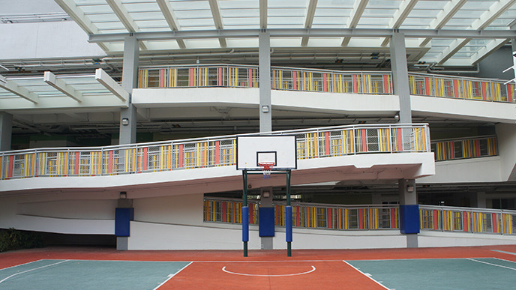
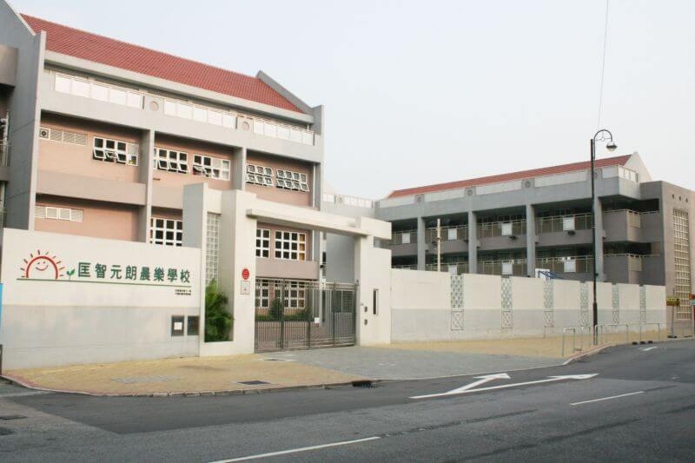
Special School – Social Work Service (SSS)
Concurrent placement only, Not necessarily provide case exposure
Daytime duty (Tue & Wed) only

Slide 21
Reminders on working hours
Students should visit the agency's website to find information about service opening hours and HKU placement website rehabilitation setting information to determine the placement preference.

Slide 22
Learning Opportunities

Slide 23
Learning Opportunities
Secondary Setting in Social Work Service
Case Management
Group/
program work
Administrative work
https://youtu.be/6P8xMRc071M

Slide 24
Attributes And Requirements
ACCEPT

Slide 25

ACCEPT
Acceptance

Slide 26

Accept
Critical mind
Challenges

Slide 27


Accept
Communication Skills: Can speak Cantonese
Creative

Slide 28

ACCEPT
Energetic

Slide 29


ACCEPT
Potentials of service users
Person-Centred

Slide 30

ACCEPT
Teamwork

Slide 31
ACCEPT

Slide 32
Correspondence of Setting Coordinator
Name : Monica Mok
Room : CJT 553
Tel : 3917 1153
Email : monicahwm@hku.hk

