Slide 1
Social Work Services in Medical Setting and Community Health

Slide 2
See, hear, feel what they see, hear and feel…..
Empathy The Human Connection to Patient Care - YouTube
https://www.youtube.com/watch?v=f4SYR4EcHlc

Slide 3
Social Work Services in Medical Setting and Community Health
Placement opportunities
MSS
Medical Social Services Unit (general, psychiatric)
MSP
Medical Special Projects and Community Health (PRC, HRC, CCSU, AMC, Apleichau Family Clinic, DHC)

Slide 4
MSS-Medical Social Services Unit (SWD/HA)
Psychosocial assessment
Case management
Care Plan and discharge planning in collaboration with interdisciplinary team
Supportive and therapeutic counselling
Referrals of tangible services
Statuary services
Outreach services
Crisis and disaster support

Slide 5
Counselling services may include:
Adjustment/acceptance to illnesses, aging and disabilities
Losses: organs, body parts, bodily functioning, roles, dignity, abilities, self-esteem, hope.
Threats and changes: daily functioning, interpersonal relationship

Slide 6
Counselling may include:
Family problems
communication problems, conflictual relationships, caregivers’ stress, financial hardship, diminished roles and discrepancies in expectations
Family violence
Physical, psychological, emotional, sexual, identification, screening and referral

Slide 7
Counselling may include:
Bereavement
Anticipatory grief and preparation for impending death of life-threatening illnesses
Follow-up the bereaved families after death in bereavement counselling and support

Slide 8
Tangible service
Help giving information, screening and referrals of tangible services, such as:
Financial (CSSA/DA/HAD,OAA, OALA, trust fund, special grant, medical waivers etc)
Information on placement (Home transfer, Spilt tenancy, CR, Emergency shelter, respite care of old aged home)

Slide 9
Tangible service
Assisting in the assessment of Elderly long term care plan and follow-up
Referral or giving information on Employment and training
Referral or giving information on other community support services

Slide 10
Discharge / Rehab. plan
Assess the care capacity of patients and their families if patients will be discharged.
Discuss the psychosocial aspects with the interdisciplinary team to plan for smooth discharge
Connect community resources or residential services for patients to sustain safe and well care.

Slide 11
Outreach service
Outreaching teams for elderly and psychiatric patients
Early Assessment Services for Young People with Psychosis (EASY) team

Slide 12
Statutory service
Mental Health Ordinance
Court report
Care and protection of children
Guardianship

Slide 13
Groups / Programs Services
Therapeutic group, supportive group, mutual help group for patient and caregivers
Psychoeducational and psychosocial programs for patients or families
Community educational programs

Slide 14
Special features for placements in MSSU (Gen/Psy)
Working methods: predominantly caseworks, only some units can have groups/programs
Working hours: Weekdays, daytime (8:45 am to 5:33 pm)
Placement students’ types:
MSSU (Gen): accept both BSW and MSW students
MSSU(Psy): prefer MSW students
Language: Cantonese fluency is expected

Slide 15
MSP- PRC/HRC, CPRC, HC
Target group
May work with patients with various illnesses or conditions, eg:
Physical illness: Cancer, cardiac disease, renal failure, diabetes, stroke, hip fracture etc.
Mental health problems: mood disorders, psychosis, dementia
Developmental issues in children & adolescents: SEN, biological or organic maldevelopment; mental health issue
Rare diseases type

Slide 16
MSP- PRC/HRC
Empowerment and support for patients and carers
Development of Mutual support network
Volunteer service and development
Community engagement and partnership
Rehab resources

Slide 17
MSP- PRC/HRC
Medical social collaboration: collaborate with medical teams, health care professionals and community partners in health promotion.

Slide 18
MSP- CPRC, HC
To provide information and support to patients and relatives in the diagnosis, treatment, rehabilitation, or palliative care phases
To empower patients in health management and decision making.
To enhance mutual support and build up self-help network of patient’s groups.
To connect patients and caregivers with community resources.
To advocate patients for dignified end-of-life care and decision making.

Slide 19
Groupwork and approaches
Cancer Support Group
(IBMS, Expressive Art, Photo-voice, Satir model, Narrative Approach, self-compassion, horticultural therapy, Acceptance Commitment Therapy)
Person in recovery
(CBT, Mindfulness, Expressive Art, strength-based, acceptance-commitment therapy, positive psychology, Lego-play)
Support group for patients with chronic illness (eg stroke, diabetes, renal failure)
(Narrative therapy, Expressive Art/Psycho-educational, expressive art)

Slide 20
Groupwork and approaches
Dementia patients and caregivers
(Cognitive stimulation therapy, reminiscence therapy, psychoeducation)
Volunteer training group
(experiential learning model)

Slide 21
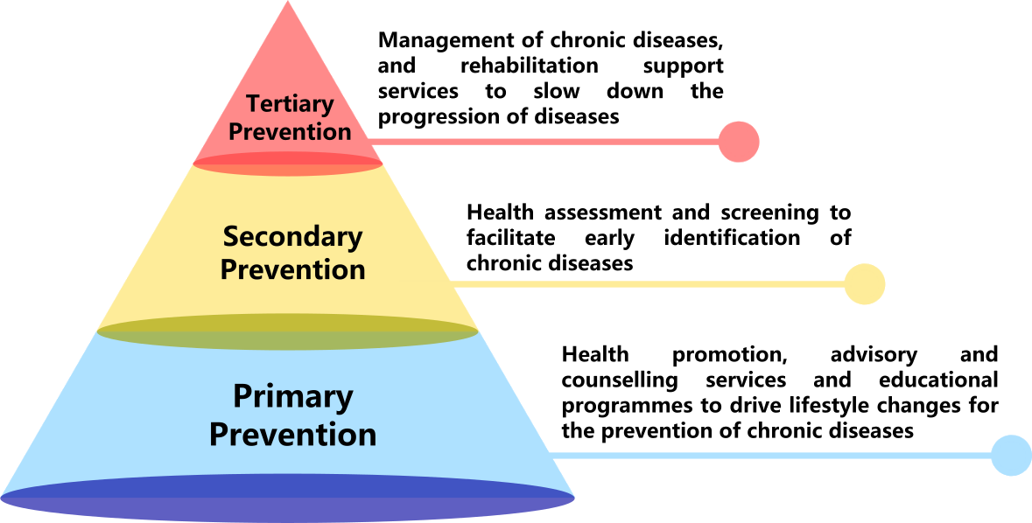
Nature and purpose of Services in Primary Care and Community Health Services

Slide 22
MSP-District Health Centre
Involve in the following scope of services
Health Promotion
Health Assessment
Chronic Disease Management
Community Rehabilitation
Can run group, educational talks, community education, booths, workshops and brief cases on disease management

Slide 23
MSP-Apleichau Family Medicine Clinic
Apleichau Family Medicine Clinic under HKU Family Medicine
Cases referrals: mood problems, carers’ stress, adjustment to illness and aging, family relationship problems, losses and bereavement, information for community resources.
4-5 case conferences with doctors of clinic and professors of HKU Family Medicine.

Slide 24
Special features for placements in MSP
Working methods:
Mainly group, program and project. No cases in PRC/HRC/CPRC/HC.
Can have casework in Adolescent Medical Centre of QEH in addition to group, program and project.
May have brief cases in DHC in addition to group and program.
Only cases in Apleichau Family Clinic.

Slide 25
Special features for placements in MSP
Working hours:
Mainly Daytime and weekdays.
Placement students’ types:
PRC/HRC (both BSW and MSW students)
Cancer Care and Support Unit /CPRC (MSW students only)
Apleichau Family Clinic (prefer MSW students) Hospice Centre/QEH (MSW students)
Adolescent and Medical Centre, QEH ( prefer MSW students)

Slide 26
Learning and Challenges in Social Work Service in medical setting and community health
Working in collaboration with inter-disciplinary team in the secondary setting
Competent verbal and written communication, able to communicate effectively in Cantonese
Active engagement with patients
Efficient work pace and assessment skills
Efficient referrals and accurate written work, update recordings according to SWD/HA format (precise, concise, accurate, clear follow-up plan)

Slide 27
Learning and Challenges in Social Work Service in medical setting and community health
Quick update of current policies and resources on tangible services eg. financial assistance, elderly and rehabilitation services, community resources and carers’ support services.
Knowledge on illness and treatment
Practice creative planning and facilitation of groups
Proactive recruitment strategies
Understand the service needs of targets suffering from various illnesses or impairments

Slide 28
Learning and Challenges in Social Work Service in medical setting and community health
Understand the carers’ stress (the impact of illness on the families)
Coordinating and collaboration with community partners
Training and monitoring of volunteers
Understand the current development of the medical reform including medical fee waiving and community pharmacy, strategic plans of HA and clusters, the development of primary care and community health care

Slide 29
Preparation and mindset
Need to attend the core volunteer training/Infection control training
Vaccinations or have immunity of chicken pox and measles
Update essential medical jargons, knowledge on chronic illnesses and mental illness
Be initiative
Be independent
Be open
Time and stress management

Slide 30
Tips in choosing medical setting for your placement
Competitive
Fluctuating placement quotas (see below)
BSW students (mostly PRC, can have MSSU in CMC and UCH)
MSW students have more choices
May need to travel long distance
No location preference may have higher chance
Availability to attend placement at daytime of Weekdays is essential

Slide 31
Tips in choosing medical setting for your placement
If choose MSS, should expect to do casework,
If choose MSP, should expect to do groupwork, program and/or project and may not have chances to do casework.
If medical as first choice, second choice should consider a less competitive choice

Slide 32

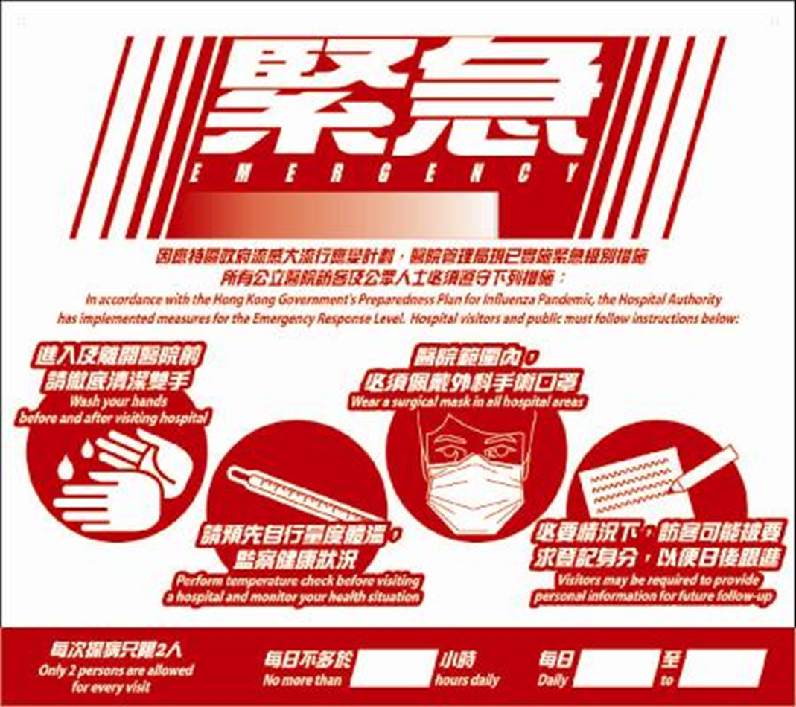
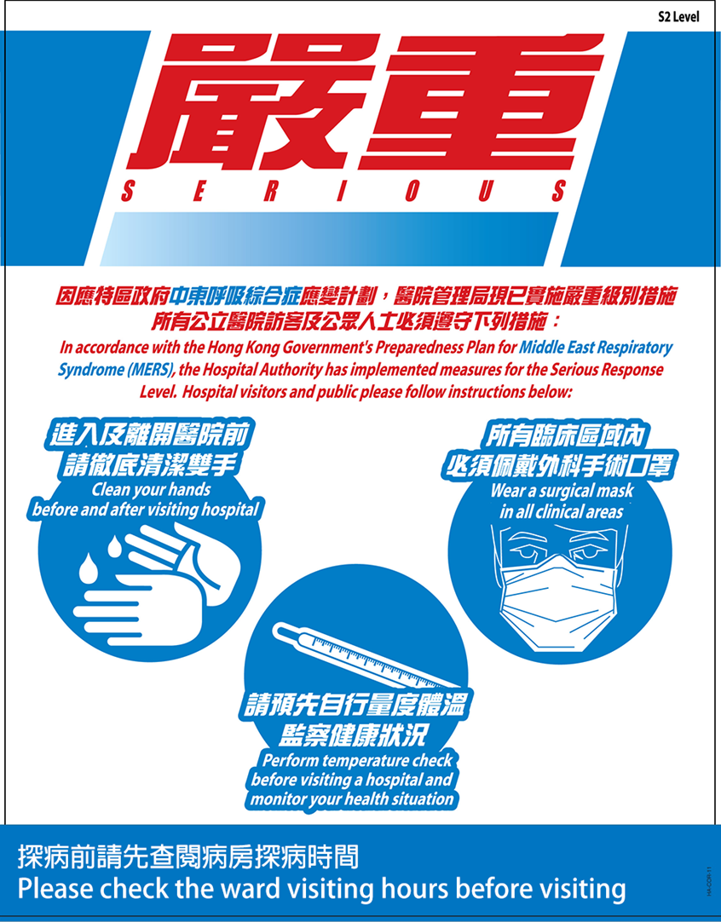
Tips in choosing medical setting for your placement
Placement may be affected or suspended under pandemics

Slide 33
Placement Units in Summer 2024 (28)
MSSU & HRC, Caritas Medical Centre
MSSU Tseung Kwan O Hospital
MSSU United Christian Hospital
MSSU Tin Shui Wai Hospital
MSSU Kwai Chung Hospital (Psy)
MSSU, North District Hospital
MSSU Queen Elizabeth Hospital
MSSU United Christian Hospital
MSSU Yung Fung Shee (Psy)
MSSU Tuen Mum Hospital
MSSU Wong Tai Sin Hospital (palliative)

Slide 34
Cont’d Summer 2024
Adolescent Medical Centre, QEH
PRC Kowloon Hospital
PRC Tuen Mun Hospital
PRC Tin Shui Wai Hospital
PRC Pok Oi Hospital
PRC Queen Mary Hospital

Slide 35
Placement Units in Concurrent 2024-25 (22)
MSSU UCH
MSSU Pamela Youde Eastern Nethersole Hospital (psy)
MSSU Tai Po Hospital (psy)
MSSU Yung Fung Shee (psy)
AMC, QEH
Apleichau clinic HKU Family Medicine
PRC Tuen Mun Hospital
Cancer PRC Tuen Mun Hospital
Cancer Care & Support Unit QMH
PRC QMH
DHC Express, Shatin, CRN

Slide 36
Placement Units in Summer 2025 (31)
MSSU & HRC, Caritas Medical Centre
MSSU Tseung Kwan O Hospital
MSSU United Christian Hospital
MSSU Prince Margaret Hospital
MSSU, North District Hospital
MSSU United Christian Hospital
MSSU Yung Fung Shee (Psy)
MSSU Haven of Hope Hospital
MSSU Taipo Hospital (Psy)
MSSU Tung Wah Hospital

Slide 37
Cont’d Summer 2025
MSSU PYNEH (psy)
MSSU PYNEH (gen)
Adolescent Medical Centre, QEH
PRC Kowloon Hospital
PRC Tin Shui Wai Hospital
PRC Pok Oi Hospital
PRC Queen Mary Hospital
Kowloon City DHCE

Slide 38
Placement Units in Concurrent 2025-26 (21)
MSSU EKPC (psy)
MSSU Tai Po Hospital (psy)
MSSU Yung Fung Shee (psy)
MSSU Wong Tai Sin Hospital (palliative)
AMC, QEH
Apleichau clinic HKU Family Medicine
PRC PYNEH
PRC Tin Shui Wan Hospital
PRC Pok Oi Hospital
Cancer Care & Support Unit QMH
PRC QMH
DHC Express, Shatin, CRN

Slide 39
Thank You
Further Enquiries
kodebby@hku.hk

