Slide 1

Fieldwork Placement 2026-27 Briefing for students Lydia Lam Director of Field Instruction 22 Nov 2025

Slide 2
Briefing Schedule
Time | Content | Speaker
9:15 – 9:30 am | Registration
9:30 - 11:00 am | General Requirement on Placement Demonstration of PMS Enrollment System | Ms. Lydia Lam Mr. Ross Lam
11:00 - 11:25 am | School Social Work Services (SSW) | Ms. Irene Law
11:25 - 11:50 am | Rehabilitation Services (RS) | Ms. Monica Mok
11:50 - 12:15 pm | Family Services (FS) | Ms. Omi Ng
12:15 - 12:40 pm | Services for Children & Youth (CYS) | Ms. Jake Pang
12:40 – 2:00 pm | Break
2:00 - 2:25 pm | Multicultural Social Work Services (MCSW) | Ms. Vicky Lee
2:25 – 2:50 pm | Community Development Services (CD) | Ms. Vicky Lee
2:50 - 3:15 pm | Services for the Elderly (ES) | Ms. Edith Fung
3:15 – 3:40 pm | Medical Social Services (MSS) | Ms. Debby Ko
3:40 – 5:15 pm | Overseas Placement Sharing and General Requirements for Overseas Placement | Students and Ms. Lydia Lam
5:15 - 5:30 pm | Q & A

Slide 3
The Importance of Fieldwork
An integral part of social work education with the emphasis on “ Learning through doing”;
Student works in a social work agency under the guidance of fieldwork supervisor as to incorporate theoretical knowledge into social work practice;
Student is expected to experience the real work setting, understand agency culture and requirement, to gain the practice wisdom from supervisor and agency staffs ;
An important process to train up a competent and independent social worker.

Slide 4
Fieldwork Objectives
Students are given opportunities to:
Demonstrate social work principles, values in actions and attitudes;
Practice theories and models and develop skills;
Enhance self-understanding, maximize potentials and own capacity
Develop own style of work within the bounds of professional practice and development

Slide 5
Fieldwork Placement Arrangement
Every student is required to undertake two fieldwork placements
As required by SWRB, students will be placed at two different service settings, with different agencies, different field-mates and different fieldwork supervisors to widen your learning opportunities
The placement will be assigned by HKU.

Slide 6
Fieldwork Modules
BSWFT3/MSW FT 1:
SOWK 4006/SOWK 6225 Fieldwork Placement I*
Summer Block Placement
Duration: Jun 1 to Aug 8, 2026 (10 weeks, 45 hours per week, completing 450 hours)
Can apply for Overseas placement :
Late May 2026 to 8 – 23 Aug 2026 (with 10 - 12 consecutive weeks, 40 – 45 hours per week, completing 450 hours)
SOWK 4007/SOWK 6231 Fieldwork Placement II
Concurrent Placement (local only)
Duration: Sep 21, 2026 to April 3, 2027 (28 weeks, 2 days (16 hours) per week, mainly on every Tues and Weds, completing 450 hours)

Slide 7
FIELDWORK MODULES
MSW PT Y3
SOWK 6231 Field Placement II *#
Concurrent Placement (local only)
Duration: Sep 20, 2027 to Apr 1, 2028
* Can apply for Overseas Placement taken in summer block, but needs to apply for deferment of Placement II to 2028 summer
# Can apply for Attachment Placement in your own employing agency, but only for social service setting agency

Slide 8
C-04 Application form for Attachment Placement
C-04 Application Form for Attachment Placement_2023.doc (live.com)

Slide 9
Attachment/On-the-job Placement
Only applies to part-time students, who are now working at social service agency
Students could apply for attachment placement once only
Students who undertake attachment placement at the working agency should be placed at a different unit to widen the learning opportunities and differentiate the role as a student social worker
For a school setting, students cannot be placed at their own working school
Students must get approval from the agency and submit supporting letters at the time of application

Slide 10
Fieldwork Modules
For all part-time students:
Please prepare your own work schedule to match the placement’s requirements.
You need to be free at least 16 hours per week (besides taking courses) to fulfil the placement’s requirement.
If you can only free weekday evening (6pm to 10pm) and weekends for placement, this will limit your placement choices.

Slide 11
Overseas Fieldwork Placement
Only applies to summer block placement
Since 1998, the SWSA has already sent a total of 330 social work students in various placement settings in different countries and places, such as Australia, Canada, Singapore, UK, USA, Guangzhou, Shanghai, Taiwan, India and Japan.

Slide 12
Roles and Responsibilities
Responsible to Agency/Clients:
“Student social worker” (實習社工)
Comply with agency policy, admin. procedures, office disciplines and proper documentation
Obtain approval before proceeding
Professional image, behaviours, appearance and dress code
Ensure confidentiality, privacy and code of ethics
Active participation and engagement

Slide 13
Roles and Responsibilities
Responsible to Supervisor/HKU
Agreement on learning goals
Responsible, active and reflective learner
Cooperative and mutual support
Paper submission on time
Well prepare for supervision
Open to share and question

Slide 14
Workload
Direct Services Guideline
First Placement
Case only : at least 4 cases
Case + group + program : 2 cases + 1 group +1 program
Group + project/program : 2 groups + 1 program OR 1 group + 2 programs /projects (both have at least 2 sessions)
Community Development project : 1-2
* The above is for reference only
* Workload is decided by mutual discussion amongst student, agency and fieldwork supervisor , while the final decision rests with the fieldwork supervisor

Slide 15
Workload
Direct Services Guideline
Second Placement
Case only : at least 5 cases
Cases + group + program: 2 -3 cases + 1 group +1 program
Group, project and program: 2 groups + 1 program or 1 group + 2 programs /projects (both have at least 2-3 sessions)
Community Development project: 1-2
* The above is for reference only
* Workload is decided by mutual discussion amongst student, agency and fieldwork supervisor, while the final decision rests with the fieldwork supervisor

Slide 16
Assessment Criteria
Assessment Criteria | 1st Placement | 2nd Placement
1. Professional Requirements | 25% | 25%
2. Organizational Requirements | 15% | 10%
3. Practice Competence | 40% | 50%
4. Written assignment and Use of Supervision | 20% | 15%

Slide 17
Assessment Criteria (Form A10a)
Failing any item in Section One results in an automatic placement failure, regardless of performance in other sections.

Slide 18
Choices of Placement Setting
Community Development Services (AG/CC/NLCDP/PHA)
Services for the Elderly (CSE/RSE)
Family Services (FSC/CISC)
Medical Social Services (MSS/MSP)
Multicultural Social Work (EDR/ASR/FDW)
Rehabilitation Services (RSD/RSR/PRS/CRN/SSS-only open for concurrent placement)
School Social Work Services (SSWP/SSWS/SSWO) – only open for concurrent placement
Services for Children & Youth (ICYSC/YR/RS)
Overseas/Mainland Fieldwork Placements (OFP) – only open for summer block placement

Slide 19
Setting Coordinators
Setting | Setting Coordinators
Community Development | Vicky Lee
Services for Elderly | Edith Fung
Family Services | Omi Ng
Medical Setting Social Work Services | Debby Ko
Multicultural Social Work Service | Vicky Lee
Rehabilitation Services | Monica Mok
School Social Work Services | Irene Law
Services for Children & Youth | Jake Pang
Overseas Fieldwork Placement | Lydia Lam

Slide 20
Consideration of Choices
Personal interest/ passion
Personal potential/ limitation
Learning expectation/ opportunities
Future Career plan
Location (near to work / home / dorm)
Placement setting’s working hours
Personal work schedule

Slide 21
Submit Preference Choices
Make 3 choices of placement setting
Indicate 2 choices of specific interest for each selected setting
Through PMS (Placement Management System) on web
Final matching result depends on availability of offers from agencies and students’ suitability
Once submitted the choices, no amendment will be allowed

Slide 22
Submit Placement Preferences
Before submitting the application,
Please read through the information being uploaded onto placement website, https://placement.socialwork.hku.hk
For BSW Students, please consult Teachers/ Skill Lab Teacher/ setting coordinators about your suitability
For MSW Students, please consult Teachers/Skills Teacher/setting coordinators about your suitability

Slide 23
District Preferences
Central, Western, Southern & Islands
Eastern & Wanchai
Kwun Tong
Wong Tai Sin & Sai Kung
Kowloon City and Yau Tsim Mong
Sham Shui Po
Tsuen Wan & Kwai Tsing
Tuen Mun
Yuen Long
Sha Tin
Tai Po & North

Slide 24
District Preferences
Please choose 2 districts among the 11 districts as your choice
Please consider the district which is more convenient for you to commit placement from dorm/home/work during the placement time. The placement venue will try to be located within the travelling time of ONE hour.

Slide 25
Placement Preference System (PMS)
Type URL as :
https://pms.socialwork.hku.hk
System will be activated on 23 November 2025, please log in on or after this date
Students will receive email notification on how to log in the system

Slide 26
Criteria for Matching Placement
No. of offers from different agencies
Special requirements stated by agencies (e.g. maturity, year of study, program of study, sex and religion, etc.)
Total number of students competing for the same placement choice

Slide 27
Criteria for Matching Placement
Suitability of Students (e.g. physically, psychologically and academically)
Recommendation from teachers
Travelling time: within ONE hour
If setting preference does not match with district preference, setting preference will over-ride district preference

Slide 28
Matching process
First preferences of every student will be matched first
If the first preference cannot be matched, then we’ll go to match the second preference and then the third preference.
For those preferences with sufficient placement offers, cGPA will not be used as a reference.
If the no. of offers from agencies is less than the no. of student first preferences, then students with higher cGPA will be placed in this first preferences. After selecting the students into the matching list, matching will not consider the academic result anymore

Slide 29
Matching Schedule
Time | Tasks
20 Dec 2025 | Collecting students’ placement preferences
3 Jan 2026 | Overseas placement interview
9 Jan 2026 | Announcement of the overseas placement application result
Late Jan 2026 | Overseas Placement Orientation Session
Mid Mar 2026 | Matching students’ summer block preferences and seek for teachers’ further comment
Early Apr 2026 | Announcement of the summer block matching results to students
9 May 2026 | Summer Block Placement Orientation Session
1 June 2025 | Commencement of Summer Block Placement
Early July 2026 | Matching students’ concurrent preferences and seeking for teachers’ further comment
Around mid- Aug 2026 | Announcement of the concurrent matching results to students
5 Sep 2026 | Concurrent Placement Orientation Session
21 Sep 2026 | Commencement of Concurrent Placement

Slide 30
Placement Management System (PMS)

Slide 31
Email Notification Sample
Dear Students,
Welcome to the SWSA Placement Management System, you can visit {{PMSStudentLink}} to complete your application for the coming summer block and/or concurrent placement in 2026/2027.
Please use your university number and attached password to enter the PMS. The PMS will be activated between 00:00 23 November 2025 and 17:00 20 December 2025.
Your password to the PMS is: XXXX
Please note these important reminders:
The system allows 20 minutes per session for processing; please keep track of your time. If it expires, click the "refresh"
button to continue.
Avoid using special symbols (such as - + # @ ! ^ & >) and excessive [Enter] spacing in the Placement Expectation and
Work Experience fields, as these may cause errors.
- Upload a clear and appropriate photo.
- Enter all information in English, except for your Chinese name if applicable.
Please remember that your work and placement experience entries may be shared with agencies and supervisors;
write thoughtfully and appropriately.
If you have any enquiries about the PMS, please contact Mr. Ross Lam at 3910 2560, or Ms. Lydia Lam at 3917 7031, lamls@hku.hk
HKU SWSA Placement Management System

Slide 32
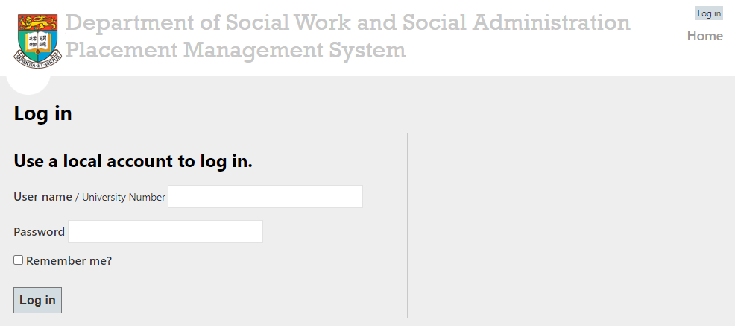
Front Page of the PMS

Slide 33
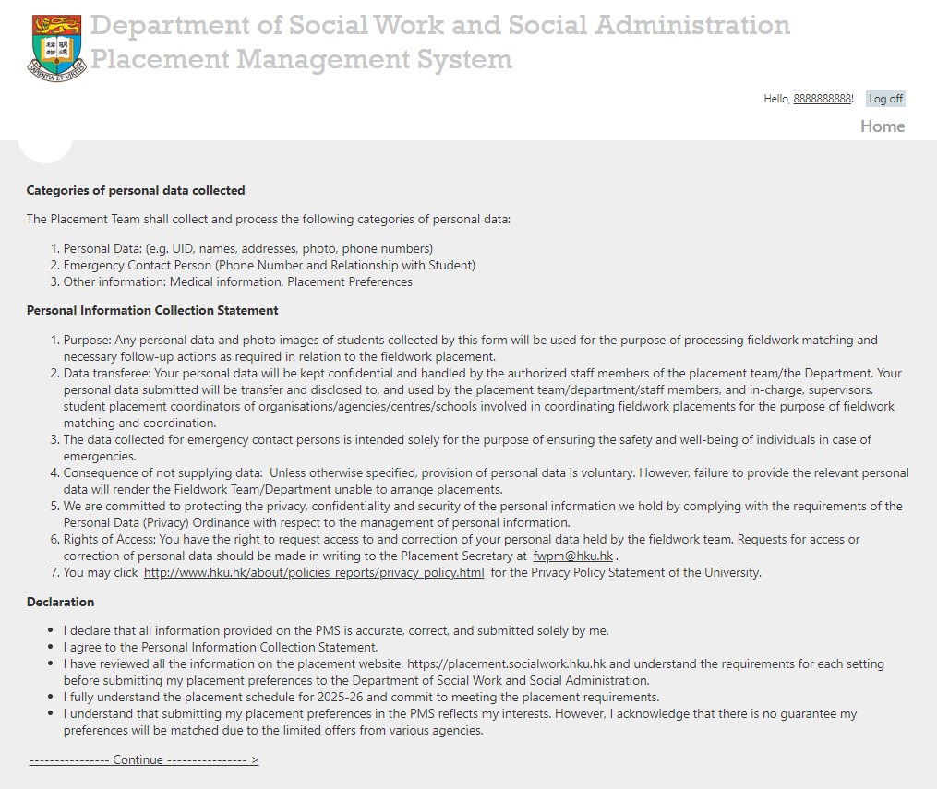

Slide 34
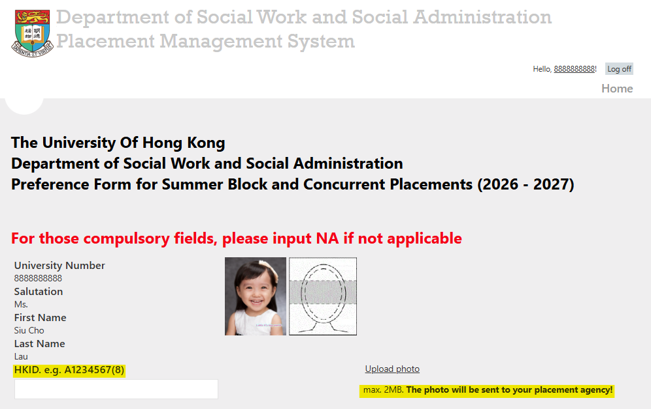


Slide 35


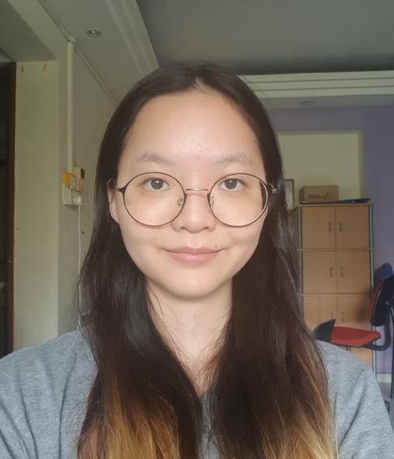








Selfie photo
Travel / Outing photo
Messy background
Inappropriate custom
Source: https://www.immd.gov.hk/
Source: https://photobi.hk/
Source: https://photobi.hk/

Slide 36
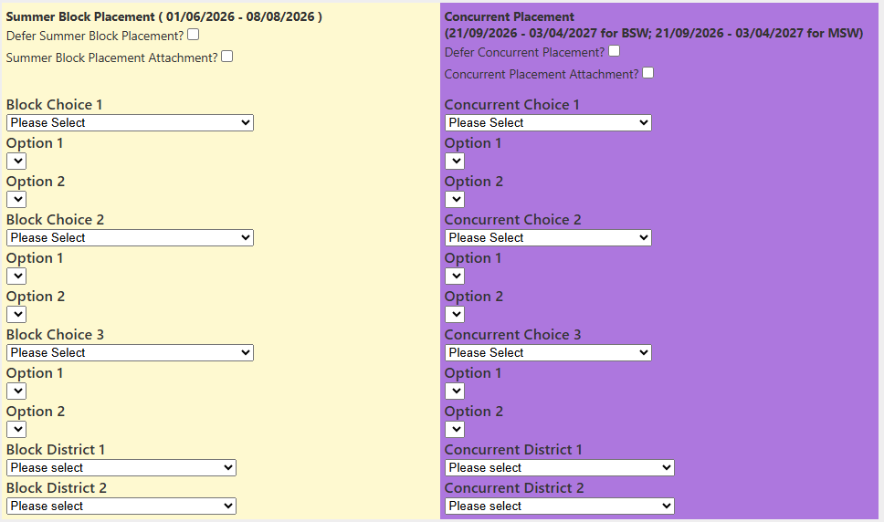
Screen for Full Time Students

Slide 37
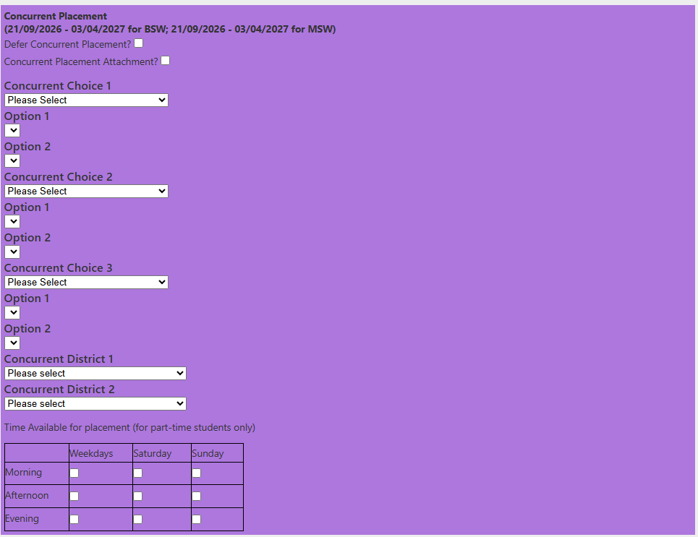
Screen for Part-time Students

Slide 38
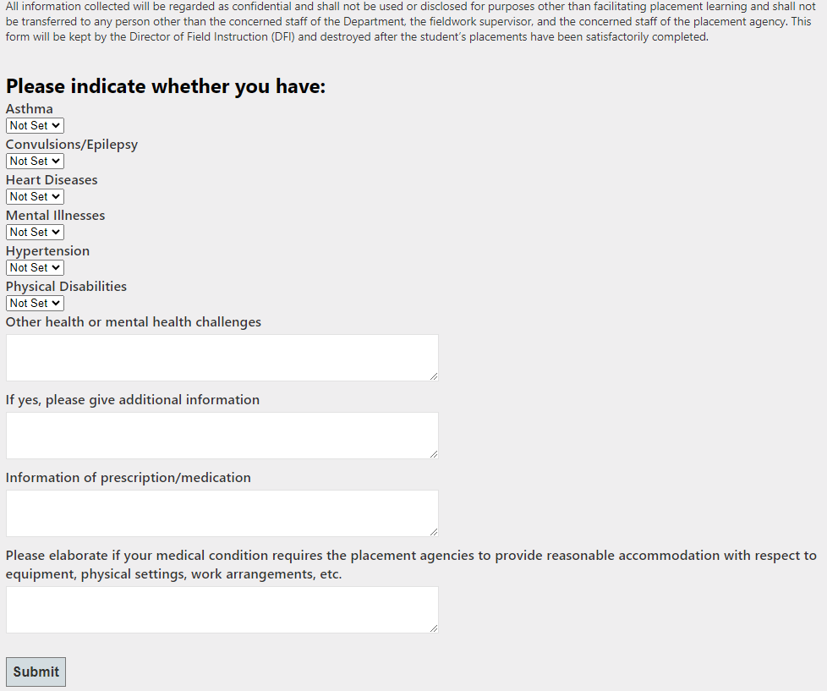

Slide 39
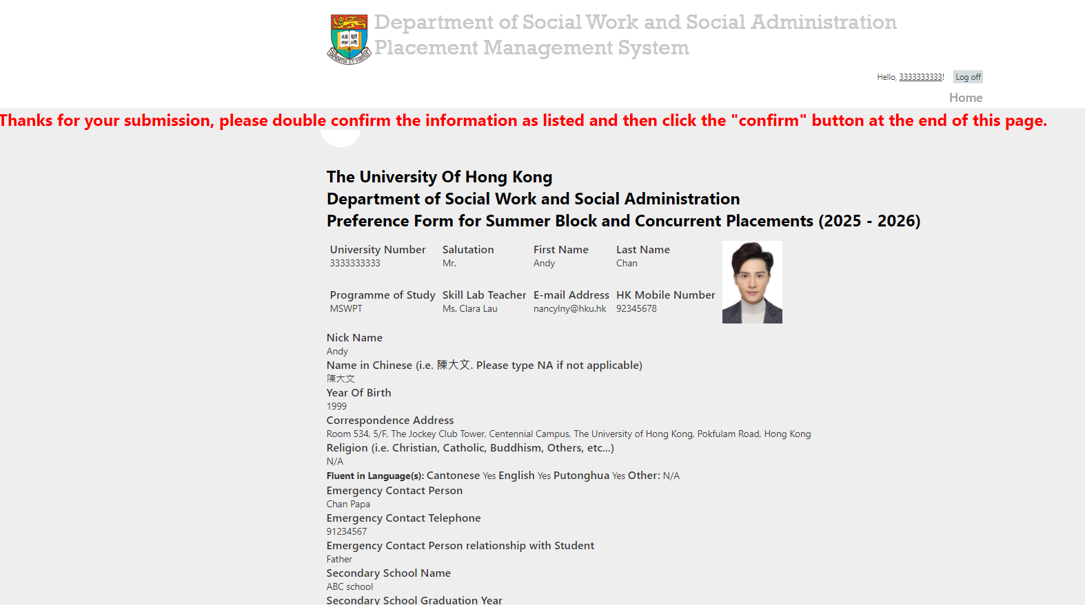
Screen after pressing the “Submit” button Please edit the information

Slide 40
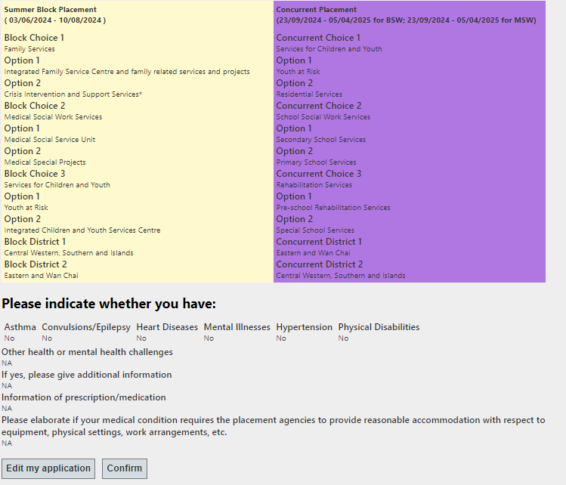
After Editing, please “Confirm”

Slide 41
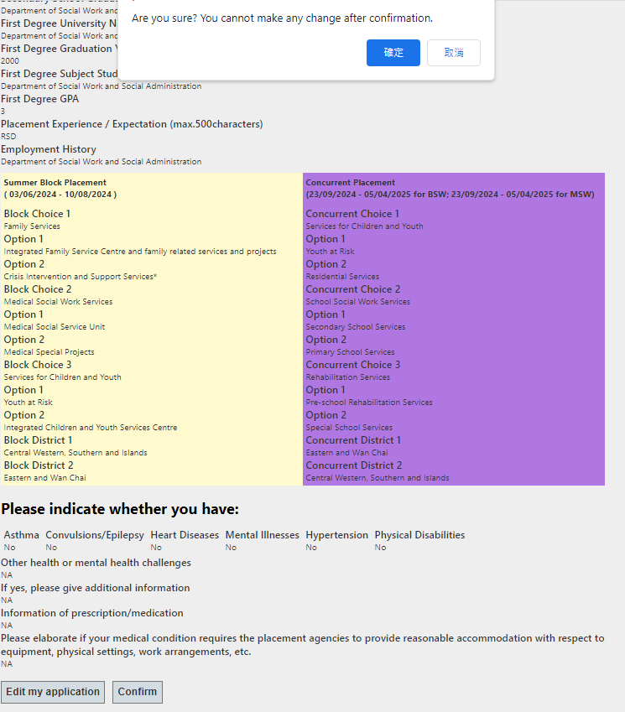
Pop up message : once confirmed, cannot change

Slide 42
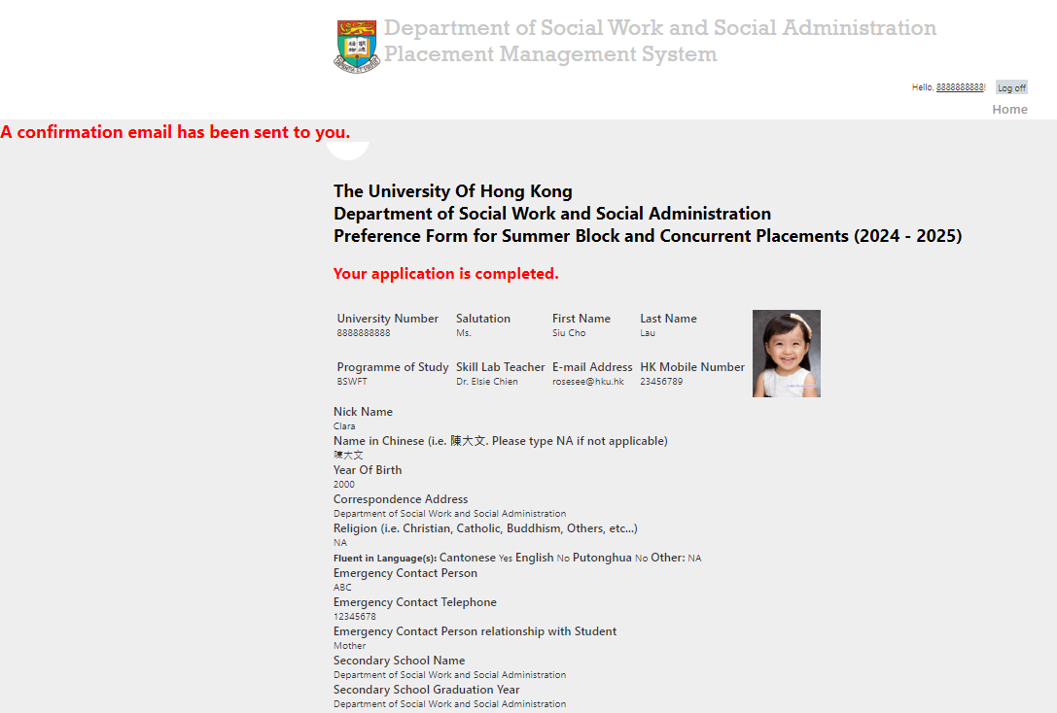
Your application is completed

Slide 43
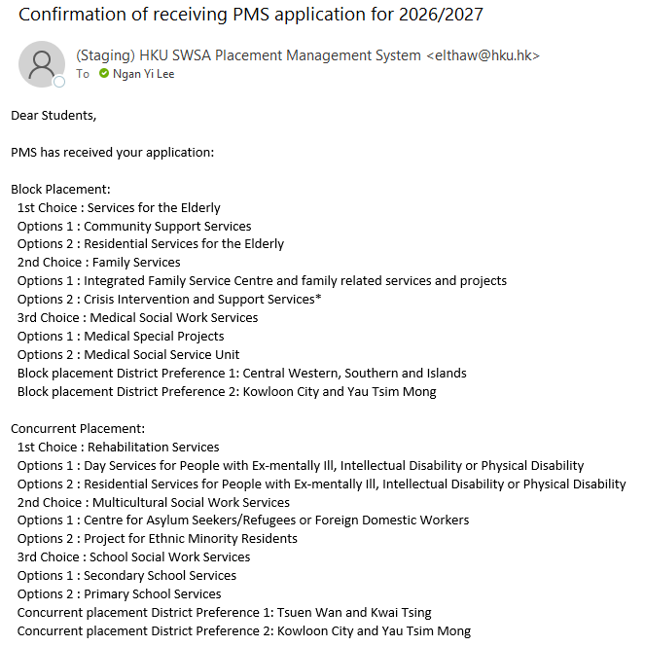

Email Confirmation Sample

Slide 44
System Demonstration

Slide 45
Important
If you haven’t received confirmation email, this implies that you haven’t confirmed all the necessary information and PMS hasn’t received your application.
Please make sure that you have gone through all the stages.
Every time, you are allowed to complete the information for 20 minutes.
Please use short paragraph to describe your placement/ work experiences/ expectation, cannot exceed 500 characters.

Slide 46
Submission Dead-line
17:00 December 20, 2025

Slide 47
Penalty for Late Submission
We’ll match all the preferences of those students who have submitted on time first and then finally settle the preferences of late submitters.

Slide 48
Good Preparation for Fieldwork Placement
Psychologically and Physically well prepared for the workloads of placement
Better to equip relevant values, attitudes, knowledge and skills of your preferred placement settings, strongly advise to match with your elective studies; be prepared to do extra study on the service nature of the clientele at your own time

Slide 49
Good Preparation for Fieldwork Placement
Good time management
Seek advice from teachers and previous students about the survival tips
Be open-minded, flexible and accept the point that “Every setting will provide learning opportunities to you”
Read Fieldwork Handbook

Slide 50
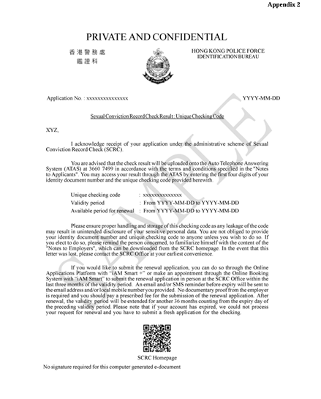
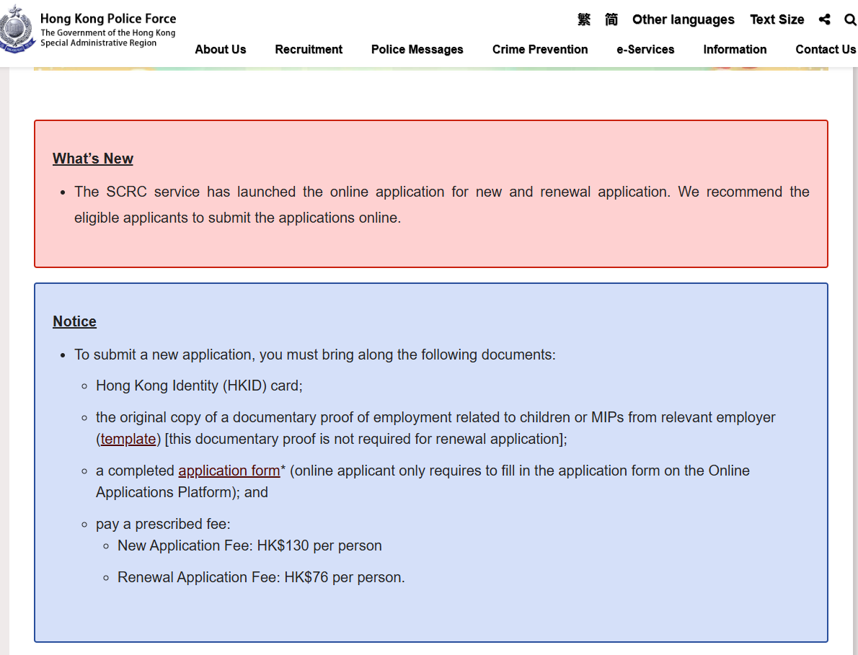
Good Preparation for Fieldwork Placement
https://www.police.gov.hk/ppp_tc/11_useful_info/scrc.html
The validity period of applications is 36 months to reduce reapplications and renewal applications.

Slide 51
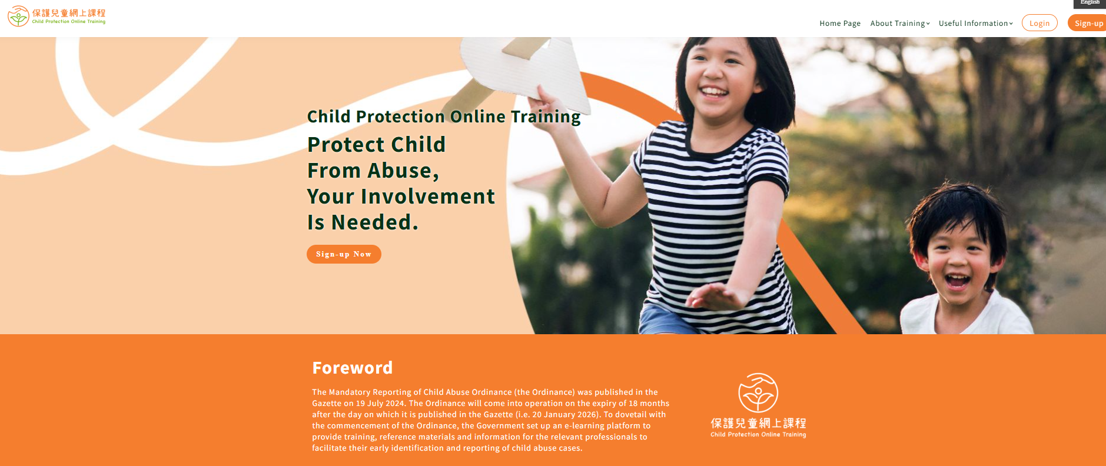
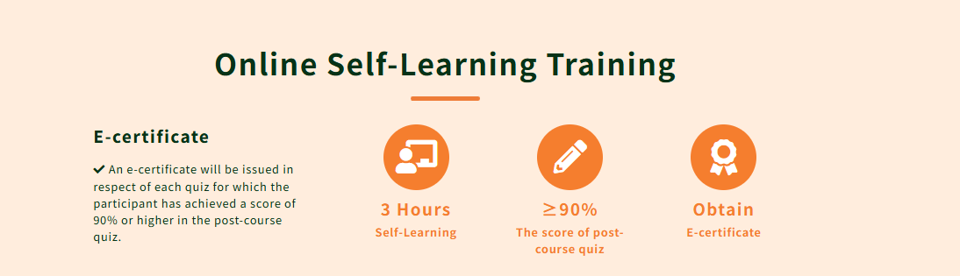
Good Preparation for Fieldwork Placement
https://www.childprotectiontraining.hk/
Complete Child Protection Online Training provided by the Government, and an e-certification will be issued.
Family service and school social work service

Slide 52
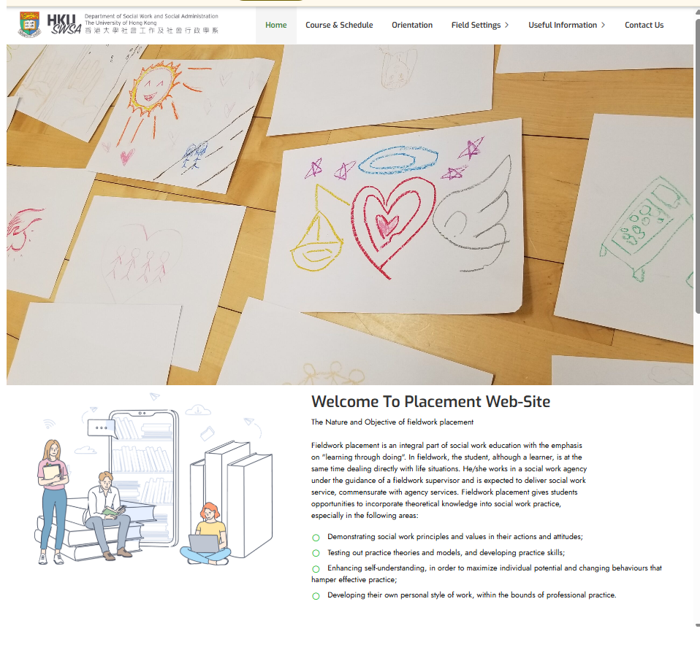
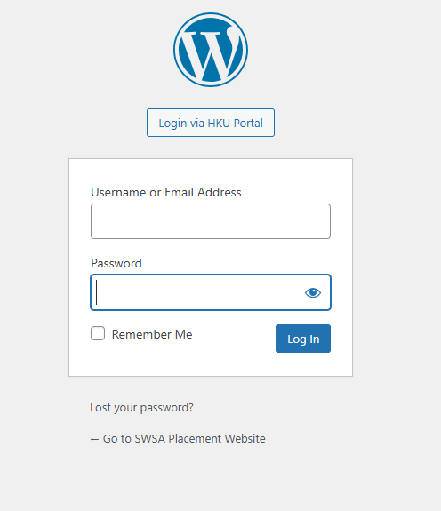
Placement Website
https://placement.socialwork.hku.hk/

Slide 53
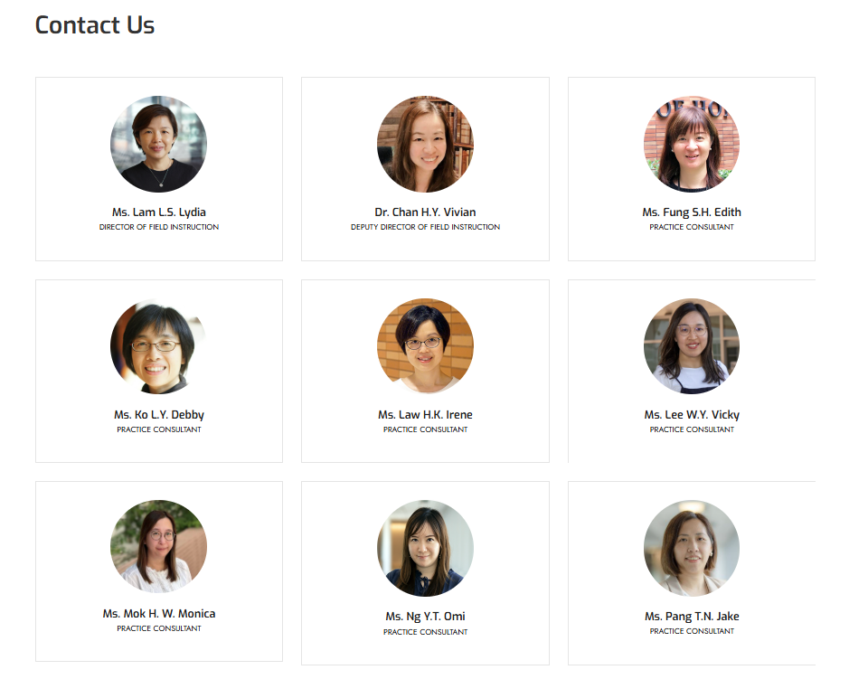

Slide 54
Central Enquiry
Contact Persons:
Ms. Lydia L.S. Lam
Director of Field Instruction
Contact: lamls@hku.hk, 3917-7031, CJT 553
Dr. Vivian Chan
Deputy Director of Field Instruction
Contact: vichan1@hku.hk, 3910-2567, CJT 556
Mr. Ross Lam
Secretary
Contact: rosslam@hku.hk, 3910-2560, CJT 534

