Slide 1


2026 – 2027 Family Services Setting Briefing
November 22, 2025
Family Service Setting Coordinator: Ms. Omi Ng

Slide 2

FAMILY
Provide an intimate environment in which physical care, mutual support and emotional security are normally available to foster the development of children into healthy and responsible members of society.
https://www.swd.gov.hk/en/pubsvc/family/cat_family/

Slide 3
Family and Child Welfare Services
To preserve & strengthen the family as a unit
To enable individuals & family members to prevent personal & family problems. To deal with them when they arise
To develop caring interpersonal relationship
To provide suitable services to meet needs that cannot be adequately met from within the family
https://www.swd.gov.hk/en/pubsvc/family/cat_family/

Slide 4

List of Family & Child Welfare Services
Charitable/ Trust Funds
Departmental Hotline Service
Family Aide Service
Family & Child Protective Services
Child Care Services
Compassionate Rehousing
Family Crisis Support Centre
Multi-purpose Crisis Intervention & Support Centre
Family Life Education
Foster Care
Integrated Family Services
Refuge Centre for Women
Services for Street Sleepers
Services for victims of sexual violence
Suicide Prevention Services
Temporary Shelter/Urban Hostel for Single Persons
Support for victims of child abuse, spouse/cohabitant battering & violence
Working Group/Advisory Committee
Adoption Service
Residential Child Care Services
Victim Support Programme for Victims of Family Violence
Short-term Food Assistance Service Team
Cross-Boundary and Inter-Country Social Services
Project on Child Care Training for Grandparents
Specialised Co-parenting Support Centre (support service for divorced/separated families)
Support Programme for Enhancing Peaceable Relationship
Outreaching Teams for Ethnic Minorities
https://www.swd.gov.hk/en/pubsvc/family/cat_family/

Slide 5
Integrated Family Services (FSC) (Operated by SWD and NGO)
Main Objective
‘Serve as a ‘community -based integrated service centre focusing on supporting and strengthening families. ‘
https://www.swd.gov.hk/en/pubsvc/family/cat_family/ifs/index.html

Slide 6

Service Content
Enquiry service, resource corner, family life education, parent-child activities, group work service, program activities, volunteer training and service, outreaching service, counselling service and referral service.
Target Group
Individuals and families in need.
https://www.swd.gov.hk/en/pubsvc/family/cat_family/ifs/index.html

Slide 7
Service Hours
3 Weekdays: 9 am – 5 pm
2 Weekdays: 9 am – 8 pm
Sat: 9 am – 1 pm
(Note: Some SWD IFSC might require BSW to start concurrent placement 2-3 weeks earlier)
https://www.swd.gov.hk/en/pubsvc/family/cat_family/

Slide 8
IFSC & FSC Services
For general reference only.
Subjected to annual placement offers from agency partners.
Could show interests or preference in PMS (i.e. IFSC, FCPSU, Crisis Centre, Gambling Service, Emergency Hostels, Hotline Service, etc.), but do not guarantee.

Slide 9

Integrated Service Centre for Social Rehabilitation & Community Support (FSC) e.g. SidebySide
Objectives:
To provide one-stop integrated rehabilitation and community support services for the ex-offenders and their family members.
To help the service users to reintegrate into the society and become law-abiding and contributive citizens.
To better prepare the inmates who are about to be released to adjust to the society.
Services:
Pre-release Preparation Service
Individual and Family Counseling Service
Health Screening and Test
Training and Employment Service
Accommodation Service
Short-term Aid
Social Skills and Interests Development Programmes
Hotline Service
https://sidebyside.org.hk/zh-hant/
Notes:
O

Slide 10
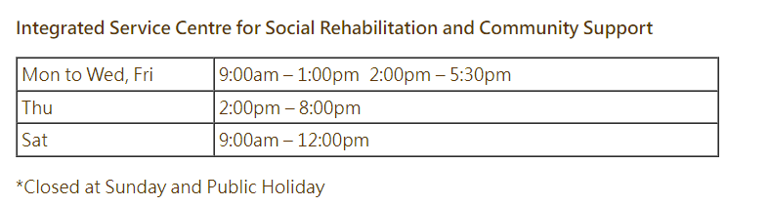
Integrated Service Centre for Social Rehabilitation & Community Support (FSC) e.g. SidebySide

Slide 11
Court Services (e.g SidebySide) (FSC)
Objectives
Provide comprehensive counseling and information services to individuals in conflict with the law.
Commit to alleviate stress and assist them to resolve their psychological and welfare problems throughout prosecution processes.
Target users:
Arrestees and people in conflict with the law of Hong Kong and their family members.
Services:
Outreaching visit:
Counselling Services
Referrals
Free Legal Advice Scheme
Court Volunteer Service
https://sidebyside.org.hk/zh-hant/

Slide 12
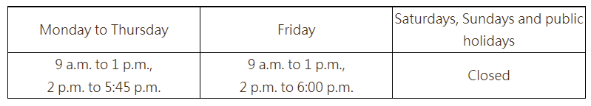
Court Services (SidebySide) (FSC)
Service Hours
https://sidebyside.org.hk/zh-hant/

Slide 13
Services for Addicted Gamblers e.g. Caritas Addicted Gamblers Counselling Centre (FSC)
Characteristics
One-stop service
Service rendered by professional counsellors / registered social workers
Family-oriented approach of intervention
Application of multi-counselling models
Supported by a team of consultants from various professions
Target users
individuals and families affected by problem gambling
Service Contents
Individual / Couple / Family Counselling
Treatment / Support Group
Debt Rearrangement
Email Counselling
Helpline Counselling
Gamblers’ Counselling Information
Emotion Support
Family Reconstruction
Volunteer Service
Community Prevention Education
Certified Gambling Counsellors Training
https://family.caritas.org.hk/eng/service05_cagcc

Slide 14

Caritas Addicted Gamblers Counselling Centre (FSC)
Service Hours
Mon, Tue, Thur 10:00 am to 6:00 pm Wed, Fri 10:00 am to 10:00 pm Sat 2:00 pm to 10:00 pm
Only Consider Master Students
https://family.caritas.org.hk/eng/service05_cagcc

Slide 15

Harmony House (FSC)(Summer Block Placement)
Objectives
First shelter for abused women and their children in Hong Kong.
To tackle the social problems of domestic violence and promote harmonious and healthy relationships in families.
To reach out to families in need through counselling and crisis intervention.
To change the misconceptions and incorrect attitude towards domestic violence through community education.
https://www.harmonyhousehk.org/en/

Slide 16
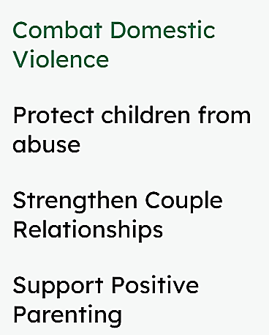
Service A one-stop anti-domestic violence service agency, with a wide range of preventive, therapeutic and developmental programmes to help families affected by domestic violence. - Shelter for women and children - Domestic Violence Prevention Centre Placement Work hours Day and/or evening duties and /or Sat
Harmony House (FSC)(Summer Block Placement)
https://www.harmonyhousehk.org/en/

Slide 17
Services for Street Sleepers
Services
e.g. Salvation Army Street Sleepers Services
Objectives
Address the emergency needs of street sleepers and enhance their work motivation and skills, so as to assist them to be self-reliant and reintegrate into the community.
Day and late-night outreach visits Emergency shelter / short-term accommodation Counselling Employment guidance | Provision of facilities for bathing, haircut and meal arrangement Emergency fund Aftercare services and service referrals, etc.
https://salvationarmy.org.hk/our_story/street-sleeper-restarts-healthy-life/?lang=en

Slide 18
Services for Street Sleepers e.g. Salvation Army Street Sleepers Services Service Hours Mon – Fri 10:00 am – 6:00 pm Sat: 10:00 am – 5:00 pm Outreach Services Hours 6:00 pm – 10:00 pm (some weekdays) Placement Work hours: Day and/or evening duties and /or Sat)
https://salvationarmy.org.hk/our_story/street-sleeper-restarts-healthy-life/?lang=en

Slide 19
Services for Underprivileged Families (FSC) e.g. ELCHK LOGIN CLUB FOR NEW ARRIVALS
Services
Counselling Services
Employment Services
Family Enrichment Services
Community Network Services
Volunteer Services
Support Services for Newly-Arrived Children & Children with Special Education Needs
Office Hour: Monday to Friday, 10:00 AM to 1:00 PM. 2:00 PM to 6:00 PM
Opening hours are subject to scheduled activities : Friday 7:00 PM to 10:00PM Saturday 10:00 AM to 1:00 PM 2:00 PM to 6:00 PM
Objectives
Providing services to support underprivileged and grassroots families.
Reaching out to our Target Groups in Kwai Chung and responding to their needs professionally.
Target users
Underprivileged and grassroots families living in Kwai Tsing (including new arrivals, single-parent families, low-income individuals, and those receiving Comprehensive Social Security Assistance).
https://service.elchk.org.hk/eng/unit_service5.php?center=48#overview

Slide 20
Objectives
Family and Child Protective Services (FCPSU) (CISC)
Protect children who are/have been harmed/maltreated
03
02
01
Safeguard the interests of children being affected by custody / guardianship disputes and referred by the Courts
Assist spouses/cohabitants who are/have been harmed in domestic violence and their family members to restore normal functioning
https://www.swd.gov.hk/en/pubsvc/family/cat_familyandc/

Slide 21
Family and Child Protective Services (FCPSU) (CISC)
Direct Services
Outreaching, investigation, early intervention, statutory protection, casework and group work services.
Supportive services including clinical psychological services, child care services, residential child care services, residential services for victims of domestic violence and family aide service.
https://www.swd.gov.hk/en/pubsvc/family/cat_familyandc//

Slide 22

Family and Child Protective Services Unit (FCPSU) (CISC)
A multi-disciplinary approach is adopted in the handling cases of child protection and domestic violence.
Work with the Police for joint investigation.
Launch Public education programmes to arouse public attention.
Students would be handling DV, IPV, and child welfare related cases.
https://www.swd.gov.hk/en/pubsvc/family/cat_familyandc/

Slide 23
Family and Child Protective Services Unit (CISC) Opening Hours
Monday to Friday: 8:45 am to 5:15 pm Saturday : 9:00 am to 12:00 pm
Only Consider Master Students.
https://www.swd.gov.hk/en/pubsvc/family/cat_familyandc/

Slide 24

https://www.youtube.com/watch?v=o6SnuViUtes

Slide 25
Multi-purpose Crisis Intervention and Support Centre (CEASE Crisis Centre, TWGH) (CISC)
Objectives
Services
Provide comprehensive support to victims of sexual violence and individuals / families facing domestic violence or in crisis and to network them with appropriate health care and social services units for necessary protection and services.
Include a 24-hour hotline and immediate counseling.
Outreaching services are provided for victims of sexual violence on 24-hour basis and victims of elder abuse after office hours of the Social Welfare Department.
Short-term accommodation service
Referral services
https://www.swd.gov.hk/en/index/site_pubsvc/page_family/sub_listofserv/id_crisisintervention/

Slide 26

Multi-purpose Crisis Intervention and Support Centre (CEASE Crisis Centre, TWGH) (CISC) Placement Work hours Afternoon and evening time, and Saturday, Sunday and public holidays
Only accept Master students who finished first placement with fair or good performance, part-time and concurrent mode.
Location is confidential, some limitations for working space.

Slide 27

Child Protection Services (CISC) e.g. Against Child Abuse (ACA)
Objectives
Services
To promote a caring and non-violent environment for the optimal growth and development of our children.
Counselling service and therapy to help the individual and families to improve their family relationship and personal development.
Parent education programmes for parents to acquire positive parenting knowledge and skills.
Family gatherings and outings to enhance mutual support among family members.
https://www.aca.org.hk/en/index.php?route=service/detail&service_id=3

Slide 28

Against Child Abuse (ACA) (CISC)
Service Hours Weekdays 9 am – 5 pm Sat: 9 am – 1 pm
Only Consider Master Students.

Slide 29
Suicide Hotline Services (CISC) e.g. Suicide Prevention Services - 生命熱線
Services:
24-hour Suicide Prevention Hotline Service
Suicide Prevention Services for the Elderly
Services for Survivors of Suicide Loss
Community & Life Education
Volunteer Training & Support
Provide support services to persons affected by suicidal behaviours (including family members & friends).
https://www.sps.org.hk/

Slide 30

Suicide Hotline Services (CISC) e.g. Suicide Prevention Services - 生命熱線
Opening hours: 24 hours Placement Work hours: Day and/or evening duties
Only consider Master Students.

Slide 31
Objectives
Services
SideBySide - Hong Kong Revival Hub, Sham Shui Po Revival Hub (Concurrent Placement)
To provide one-stop integrated rehabilitation and community support services for the ex-offenders and their family members.
To help the service users to reintegrate into the society and become law-abiding and contributive citizens.
To better prepare the inmates who are about to be released to adjust to the society.
Pre-release Preparation Service & Short-term Aid
Individual & Family Counselling Service, Hotline Service
Health Screening and Test
Accommodation, Training & Employment Service, Social Skills & Interests Development Programmes
https://sidebyside.org.hk/en/services/rehabilitation/IntegratedService/isc/?back=fda61ee468b0e0161596dd66f5891356/

Slide 32
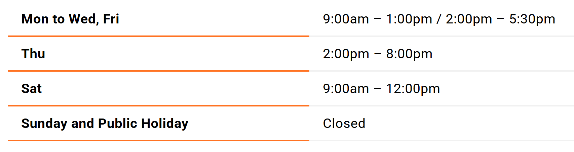
Service Hours
SideBySide - Hong Kong Revival Hub, Sham Shui Po Revival Hub (Concurrent Placement)
https://sidebyside.org.hk/en/services/rehabilitation/IntegratedService/isc/?back=fda61ee468b0e0161596dd66f5891356/

Slide 33
St. James' Settlement - Integrated Services for Street Sleepers
(Concurrent Placement)
Objectives
We aim to improve the quality of living and social integration for street sleepers and people with immediate risk of becoming homeless.
We provide street sleepers with basic supplies and supporting services for their urgent needs before they have a stable accommodation.
Services
Daytime & Mid-night Outreaching
Supplies such as food, blankets, quilts, clothes and coats donated
Emergency & Short-term Accommodation
Employment programs and vocational counselling are provided for independence living support
https://isss.sjs.org.hk/

Slide 34
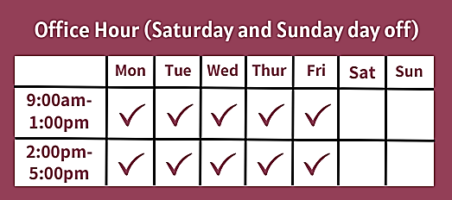
Service Hours
St. James' Settlement - Integrated Services for Street Sleepers
(Concurrent Placement)
https://isss.sjs.org.hk/

Slide 35
The Neighbourhood Advice-Action Council: Tung Chung Integrated Services Centre
(For Family Development & Support Service)
(Summer Block Placement)
Objectives & Services
Integrated Family Service Centre: to provide a spectrum of services to address the multifarious needs of individuals, strengthen problem-solving ability and develop the full potential of all people for whole-person development.
​District Support Scheme for Children and Youth Development; ​Integrated Children and Youth Services Centre; After-School Care Service Centre: to facilitate the personal development of children and youth to develop their life skills, potentials and problem-solving.
District Elderly Community Centre & Support Team for the Elderly; Day Care Centre for the Elderly: to provide care, including rehabilitation training, counselling, referrals, social and recreational activities, meals, transportation, elderly attention and personal care.
https://www.naac.org.hk/en/our_services/family_and_child_welfare_service/integrated_services_centre/tcis/

Slide 36
The Neighbourhood Advice-Action Council: Tung Chung Integrated Services Centre
(For Family Development & Support Service)
(Summer Block Placement)
Service Hours
Subjected to Services & Team Arrangements
General Reference:
Monday – Friday & Saturday: 8:00 am – 10:00 pm
Several Sunday: 2:00 pm – 6:00 pm
https://www.naac.org.hk/en/our_services/family_and_child_welfare_service/integrated_services_centre/tcis/

Slide 37
Placement Days 2 Full-day weekday duties are required for all Family Services except the following Services. They can accommodate placement hours on some weekday Day/evenings and Sat whole day: CISC - Suicide Prevention Services FSC - Salvation Army Street Sleepers Services - Hong Kong Federation of Women's Centres, Lai Kok Centre - Caritas Addicted Gamblers Counselling Centre

Slide 38

Self-Learning: Child Protection Online Training
The Mandatory Reporting of Child Abuse Ordinance (20 January 2026): Professionals who have frequent contact with children in the course of their work, should have the responsibility to safeguard the best interests of the children and to protect them from abuse.
The online self-learning training consists of two modules, each takes about 3 hours. An e-certificate will be issued in respect of each quiz for which the participant has achieved a score of 90% or higher in the post-course quiz.
To be completed BEFORE start of placement, Online Course Link:
https://www.childprotectiontraining.hk/self-learning

Slide 39
Attitude & Work Discipline
Punctual, be Early
Self-initiative & Proactive to learn from service team
Responsibilites
Polite, Respect
& Care
Accountable & Confidentiality
Self-discipline with good time & workload management
Flexible & willing to shoulder additional duties
Blend into the team & Dress Code

Slide 40
Adjusting Expectations
Floating seats arrangement (e.g. Pantry, meeting rooms, etc.), stable seats are not always guaranteed due to agency setting.
Possibilities to interact with service users, drop-ins or service users would be limited at times.
Be flexible and blend into the agency culture.
Be proactive in shouldering ad hoc learning opportunities (e.g. Observing intake, outreaching, home visits, community mass programs, etc.).

Slide 41
Professional Knowledge
Community Resources & Services
Relative Conceptual & Intervention Models
Needs of Different Service Users
Communication Skills & Risk Assessment skills

Slide 42

THANKS
Ms. Omi Ng
Family Services Setting Coordinator
Email: oytng@hku.hk

