Slide 1

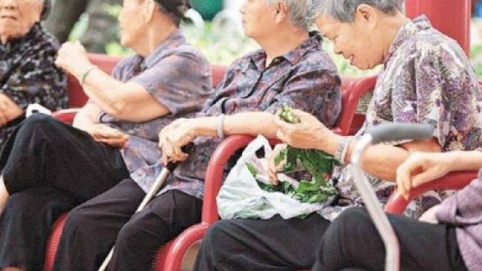
2026-2027 Placement Briefing Elderly Service Setting (ES)
Prepared by Edith Fung Siu Ha
22 November, 2025
Photo Source: on.cc

Slide 2


Knowing you ……. * how many of you thinking of choosing ES in one of the 2 placement choices ? * what are the thoughts you have about ES placement ?
白花油味。。。
好悶， 好慢，
好SAD。。。。
手工藝，懷舊 。。。。
Notes:
By 2050, the world’s population aged 60 years and older is expected to total 2 billion, up from 900 million in 2015.
Today, 125 million people are aged 80 years or older. By 2050, there will be almost this many (120 million) living in China alone, and 434 million people in this age group worldwide. By 2050, 80% of all older people will live in low- and middle-income countries.
The pace of population ageing around the world is also increasing dramatically. France had almost 150 years to adapt to a change from 10% to 20% in the proportion of the population that was older than 60 years .However, places such as Brazil, China and India will have slightly more than 20 years to make the same adaptation.
While this shift in distribution of a country's population towards older ages – known as population ageing - started in high-income countries (for example in Japan 30% of the population are already over 60 years old), it is now low- and middle-income countries that are experiencing the greatest change.

Slide 3
Today’s Agenda
Give you a reason – Why ES ?
What will you experience in the ES placement ?
What are the key considerations & Requirements?
Q&A
Notes:
By 2050, the world’s population aged 60 years and older is expected to total 2 billion, up from 900 million in 2015.
Today, 125 million people are aged 80 years or older. By 2050, there will be almost this many (120 million) living in China alone, and 434 million people in this age group worldwide. By 2050, 80% of all older people will live in low- and middle-income countries.
The pace of population ageing around the world is also increasing dramatically. France had almost 150 years to adapt to a change from 10% to 20% in the proportion of the population that was older than 60 years .However, places such as Brazil, China and India will have slightly more than 20 years to make the same adaptation.
While this shift in distribution of a country's population towards older ages – known as population ageing - started in high-income countries (for example in Japan 30% of the population are already over 60 years old), it is now low- and middle-income countries that are experiencing the greatest change.

Slide 4
Why ES?
United Nations
Latest trends in Population Ageing
According to the World Population Prospects 2022, the population above the age of 65 years is growing more rapidly than the population below that age.
The proportion of people aged 65 years and above is increasing at a faster rate than those below that age. This means that the percentage of the global population aged 65 and above is expected to rise from 10% in 2022 to 16% in 2050.
It is projected that by 2050, the number of individuals aged 65 years or above across the world will be twice the number of children under age 5 and almost equivalent to the number of children under 12 years.
Source:https://www.un.org/en/global-issues/ageing#:~:text=Trends%20in%20Population%20Ageing,11%20in%202019%20(9%25).
Notes:
Population ageing – a global issue.
Last time it took placed in developed countries at a slower pace.
France had almost 150 years to adapt to a change from 10% to 20% in the proportion of the population that was older than 60 years .However, places such as Brazil, China and India will have slightly more than 20 years to make the same adaptation.
Dependency rate dropped
Demographic shift is a challenge to the health and social systems

Slide 5
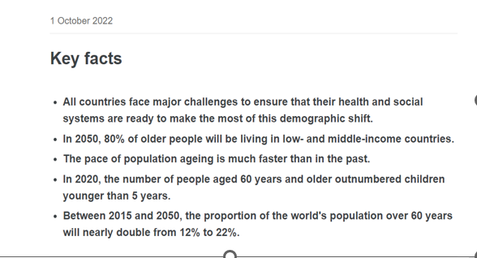
Why ES?
World Health Organization
Source: https://www.who.int/news-room/fact-sheets/detail/ageing-and-health
Notes:
Population ageing – a global issue.
Last time it took placed in developed countries at a slower pace.
France had almost 150 years to adapt to a change from 10% to 20% in the proportion of the population that was older than 60 years .However, places such as Brazil, China and India will have slightly more than 20 years to make the same adaptation.
Dependency rate dropped
Demographic shift is a challenge to the health and social systems

Slide 6
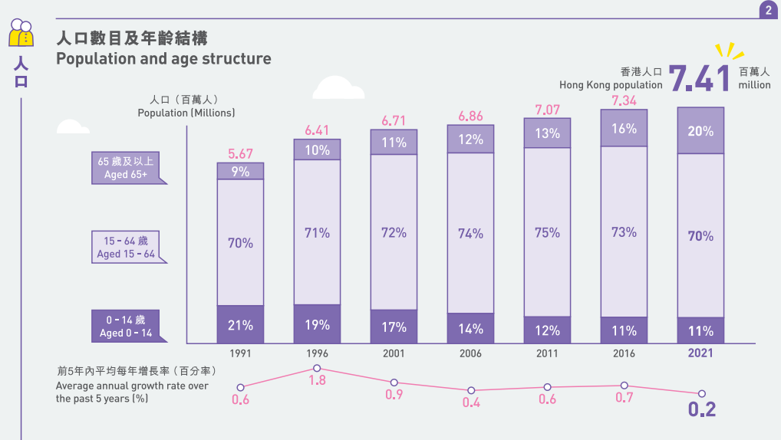
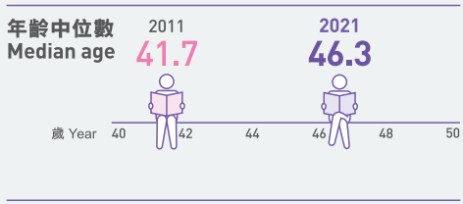
Hong Kong
Population Census Key Statistics 2021人口普查 主要統計
Source: https://www.censtatd.gov.hk/en/data/stat_report/product/B1120107/att/B11201072021XXXXB0100.pdf
Notes:
HK’s situation copies the world trend. 2021 Population Census shows…….

Slide 7
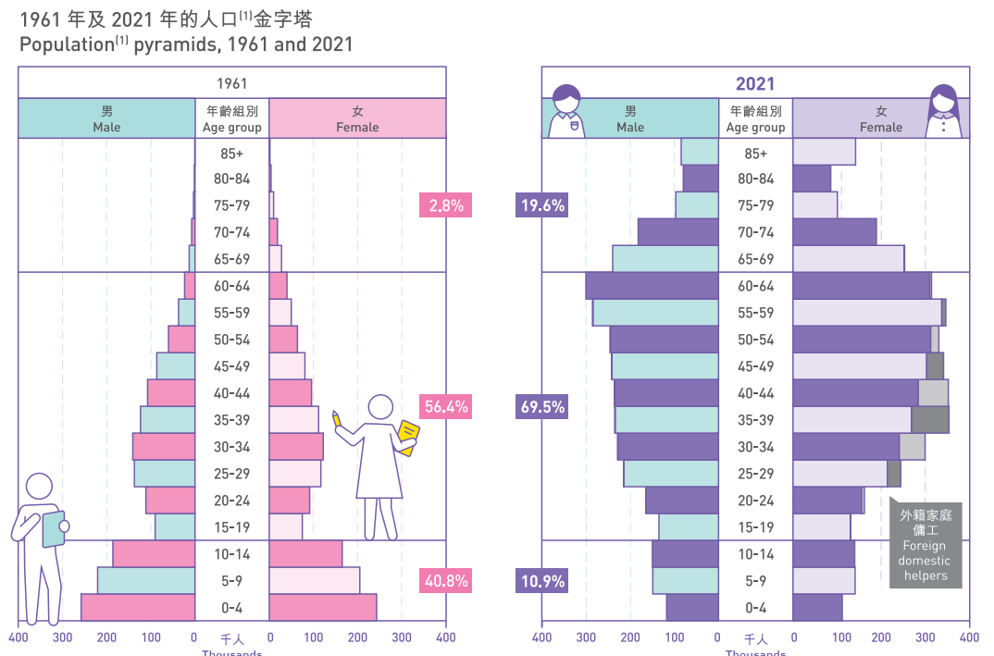
Hong Kong Population Pyramid 1961 vs 2021
Source: https://www.census2021.gov.hk/doc/pub/21C_Articles_Demographic.pdf
Notes:
Hong Kong population was ageing rapidly
Demographic shift as shown in the 2 population pyramids

Slide 8

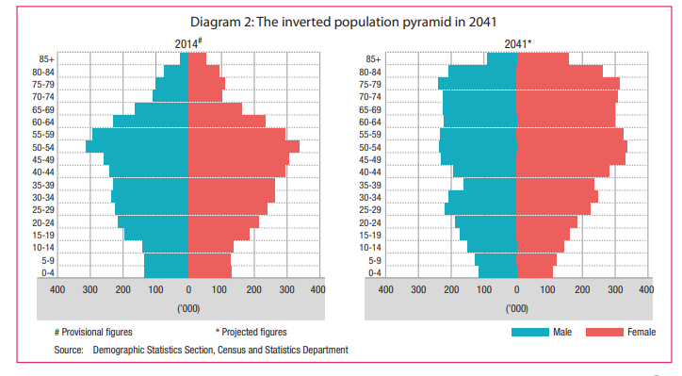
Hong Kong Population Pyramid 2014 vs 2041
Source: https://gia.info.gov.hk/general/201501/15/P201501150880_0880_140608.pdf
Notes:
Hong Kong population was ageing rapidly
Demographic shift as shown in the 2 population pyramids

Slide 9
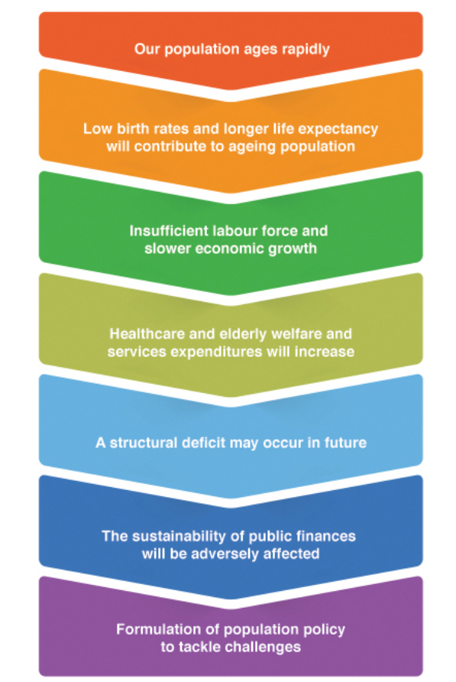
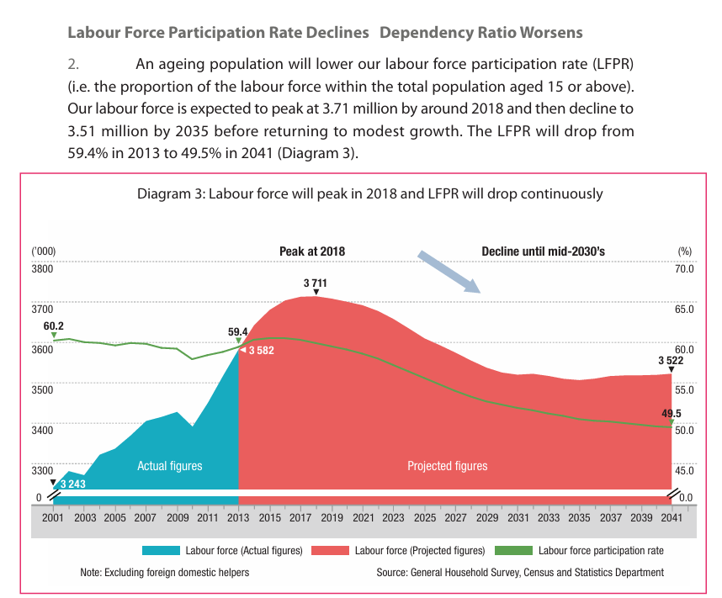
Hong Kong
Source: https://gia.info.gov.hk/general/201501/15/P201501150880_0880_140608.pdf
Notes:
Hong Kong population was ageing rapidly
Demographic shift as shown in the 2 population pyramids

Slide 10
Hong Kong Population Pyramid 2014 vs 2041
Embracing Opportunities in an Ageing Society
Some examples:
The "$2 Public Transport Fare Concession Scheme“
The Hong Kong Housing Society (HKHS) launched the "Age-in-Place" (AIP) Scheme in its rental estates for elderly residents to fulfill their aspiration to age in place
The Reverse Mortgage Scheme of the Hong Kong Mortgage Corporation Limited enables the elderly to use their self-occupied residential properties as security to borrow from a bank
The Senior Citizen Residences Scheme operated by the HKHS provides a one-stop service of housing, community recreation and medical care services to the elderly who have means to lead an independent life.
Implement the Guangdong Scheme, to help eligible elderly people who choose to reside in Guangdong to receive the Old Age Allowance
Source: https://gia.info.gov.hk/general/201501/15/P201501150880_0880_140608.pdf
Notes:
Hong Kong population was ageing rapidly
Demographic shift as shown in the 2 population pyramids

Slide 11
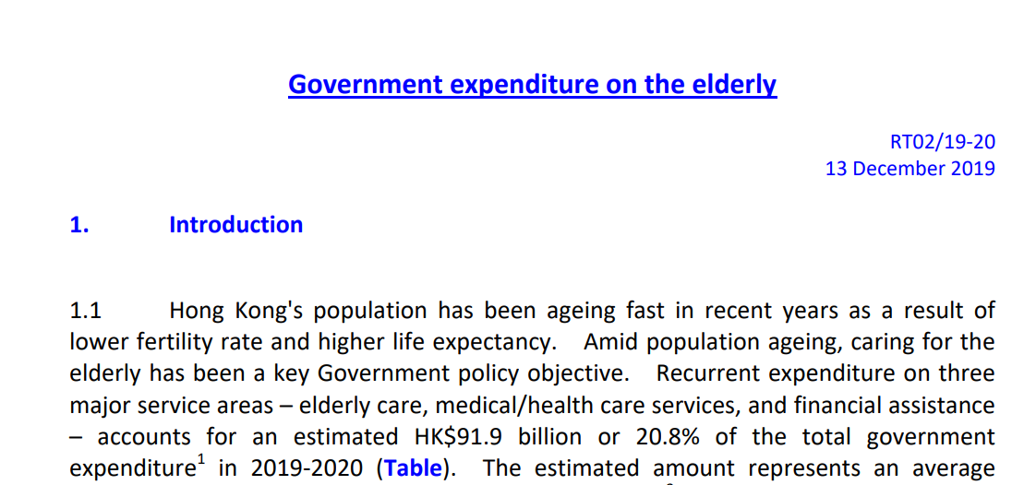
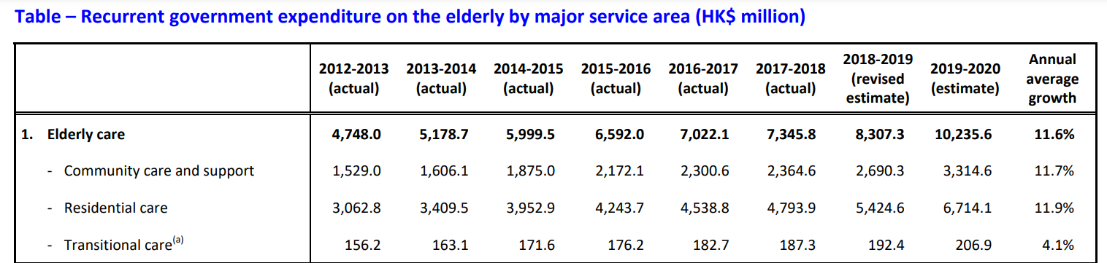
Hong Kong
Source: https://www.legco.gov.hk/research-publications/english/1920rt02-government-expenditure-on-the-elderly-20191213-e.pdf
Notes:
Government expedtures on the elderly keep increasing with annual average growth of 11.6%

Slide 12
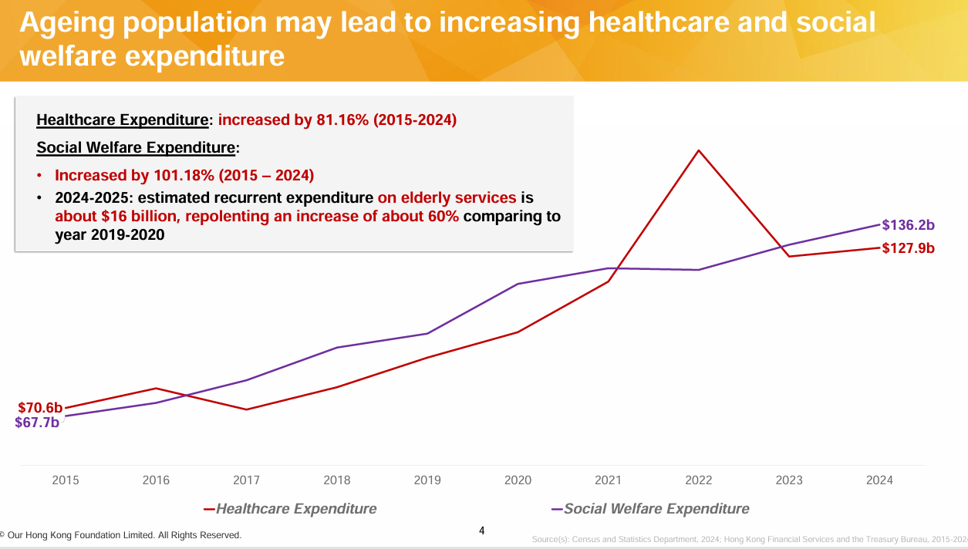
Sou
Source: Extract from “Policy Path to Ageing in Place for Hong Kong: Shaping an Inclusive Housing and Community Landscape April 2025”

Slide 13
What’s been done by HKSAR since 2022?
The Social Welfare Department (SWD) will regularise the Pilot Scheme on Community Care Service Voucher for the Elderly in the third quarter of this year (2023) to gradually increase the number of beneficiaries from the current 8 000 to 12 000 in 2025-26. It will also set up 16 new Neighbourhood Elderly Centres starting from this year to 2027. As for day care services, the Government plans to provide an additional 900 service places in the coming five years. The Government will also expand the HA's Integrated Discharge Support Programme for Elderly Patients in the third quarter of this year by increasing the number of beneficiaries by one-third to 45 000 per year. As for residential care services for the elderly, the Government is making its greatest effort to increase the number of service places by forging ahead the Enhanced Bought Place Scheme, Government contract home development projects that are being implemented as well as projects under the Special Scheme on Privately Owned Sites for Welfare Uses that have entered construction or detailed design stage. It is the Government's target to provide an additional 6 200 subsidised residential care places by end-2027, of which 2 600 will commence service by the end of this year. Furthermore, the SWD has increased the number of beneficiaries under the Residential Care Service Voucher (RCSV) for the Elderly from 3 000 to 4 000 in 2022-23, and will regularise the RCSV Scheme in April this year as well. In 2023-24, the Government's estimated recurrent expenditure on elderly persons has reached $123.1 billion, which is 70 per cent higher than the $71.0 billion in 2017-18, and in turn demonstrates the Government's commitment to the elderly amid an ageing population.
Ends/Wednesday, March 22, 2023
(Press release : https;//www.info.gov.hk/gia/general/202303/22/P2023032200177.htm

Slide 14

It will increase demand for primary health care and long-term care, require a larger and better trained workforce and intensify the need for environments to be made more age-friendly.
Notes:
Danger = posting social and economic challenges e.g slow down the economy ;
Opportunity = job opportunity in health care and long care care sector

Slide 15

UN Decade of Healthy Ageing 2021 - 2030

Slide 16
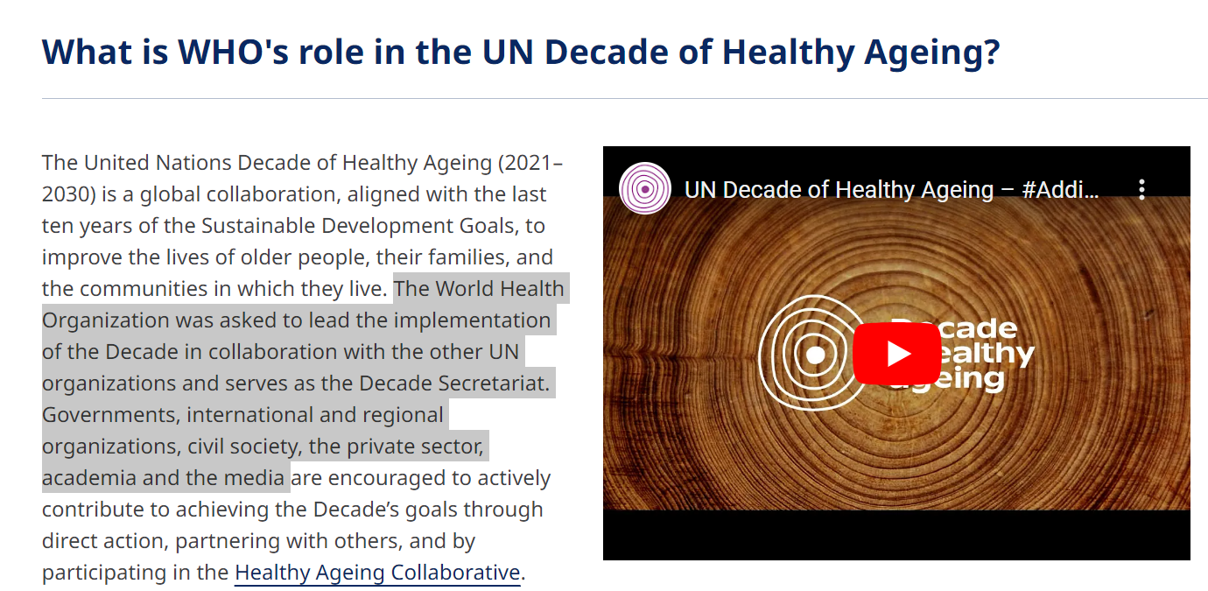
UN Decade of Healthy Ageing 2021 - 2030
Source: https://www.who.int/initiatives/decade-of-healthy-ageing
Notes:
Advocate multiple stakeholder collaboration and to invest in 10 priorities

Slide 17
10 Priorities
Establishing A Platform For Innovation and Change
Supporting Country Planning & Action
Collecting Better Global Data on Healthy Ageing
Promoting Research that Address the Current and Future Needs of Older People
Aligning Health Systems to the needs of older people
Laying the Foundations for a Long-Term-Care system in every country
Ensuring the human resources necessary for the Integrated Care
Understaking a Global Campaign to Combat Ageism
Defining the Economic Case For Investment
Enchancing The Global Network for Age-Friendly Cities & Communities
Source: https://www.who.int/ageing/en/

Slide 18
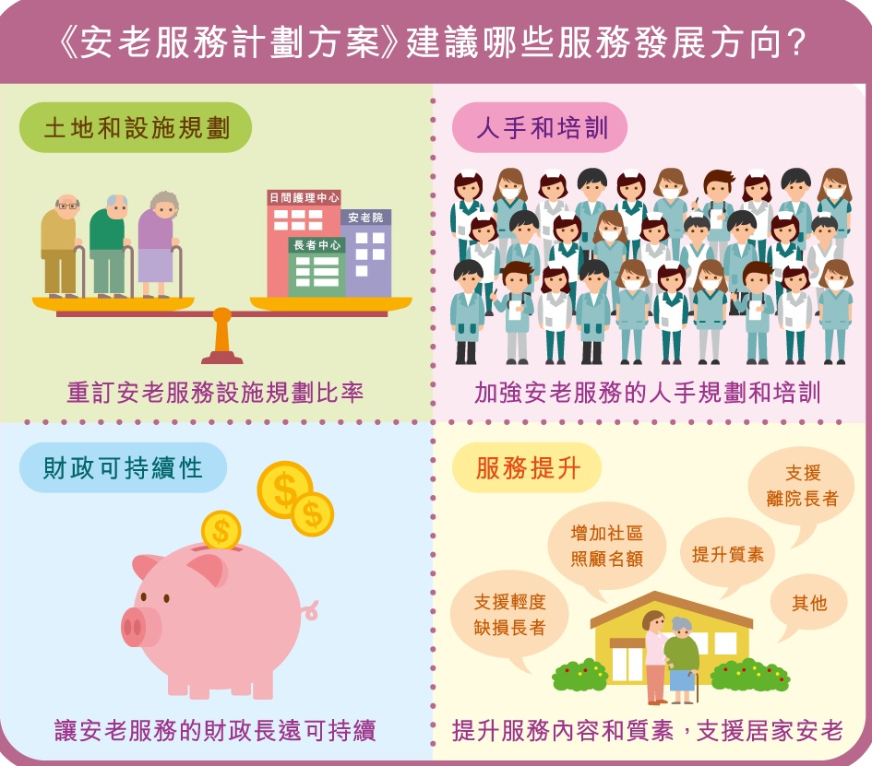
Hong Kong (Elderly Commission 安老事務委員會)
Source:https:// www.elderlycommission.gov.hk/tc/about-us/elderly-services-programme-plan/
Notes:
Elderly Commission
In 1997, the HKSAR has made “Care for the Elderly” a Strategic Policy Objective
The objective is to improve the quality of life of our elderly population and to provide them with a sense of security, a sense of belonging and a feeling of health and worthiness.
The Elderly Commission was established in the same year and its main task is to provide advice to the Government of the HKSAR in the formulation of a comprehensive policy in caring for elders.
Terms of Reference
To advise Government on the formulation of a comprehensive policy for the elderly including matters relating to the care, housing, financial security, health and medical, psychological, employment and recreational needs of the elderly;
To co-ordinate the planning and development of various programmes and services for the elderly, and to recommend priorities for implementation having regard to manpower, financial and other resources available; and
To monitor implementation of policies and programmes affecting the elderly, and to make recommendations to Government to ensure that agreed objectives are met.

Slide 19

Hong Kong
2014
1999
1998
2010
Notes:
Research and Data Gathering

Slide 20
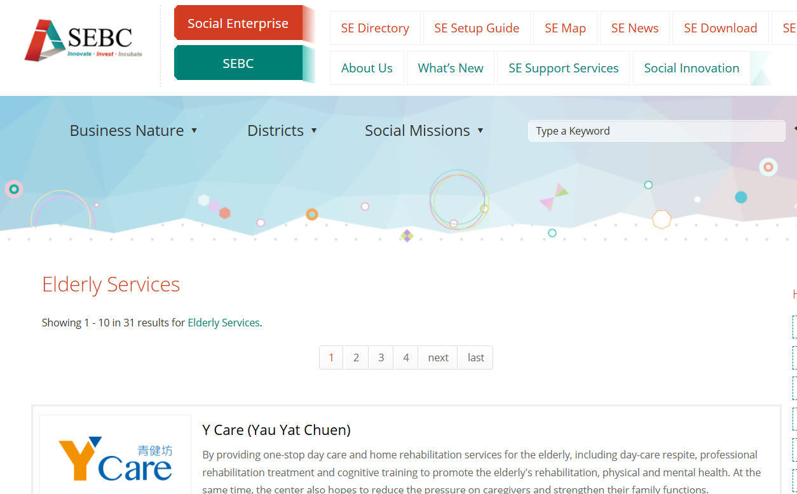
Social Enterprises
Source: https:// socialenterprise.org.hk/en/sedb/tags/4EKHku3DTg22NwSVjdS8cg

Slide 21
Social Enterprises / Self-finance services
尊賢會
(The Jade Club)
https://www.thejadeclub.com.hk/
銀杏館
(Gingko House )
https://www.gingkohouse.hk
基督教香港信義會社會服務部「金齡薈」
https://service.elchk.org.hk/unit_service3.php?center=76
仁愛堂田家炳銅鑼灣長者活動中心
https://se5.yot.org.hk

Slide 22
Projects JC Joyage 2016 – present
Jockey Club Holistic Support Project for Elderly Mental Wellness
賽馬會樂齡同行計劃樂齡友里樂齡之友身心健康行動計劃
The project aims to enhance the community capacity in older adults mental support, promote effective coordination among district elderly services and community mental health services, improve service access and coverage for older adults in need, and exert positive influence on families and the neighbourhood to improve mental health literacy.
Source:https://jcjoyage.hk/

Slide 23
Projects JC Age–friendly City 2015 – present
Jockey Club Age-friendly City
香港賽馬會長者及年齡友善城市
Objectives:
Assess the age-friendliness of each district and build momentum in developing an age-friendly community
Recommend a framework for districts to undertake continual improvement for the well-being of senior citizens
Arouse public awareness and encourage community participation in building an age-friendly city
Source: https://www.jcafc.hk/en/index.html

Slide 24
Successful Aging (Rowe and Kahn 1987) OpPORTUNITY - Successful Aging Projects 賽馬會50+共創豐盛計劃
以「創業」為平台，
50+在過程中加深認識社會需要，
共同發揮個人專長和專業知識，
發展以「社會創新」為理念的項目服務社會大眾；
同時協助50+探索方向，為人生下半場帶來更多機遇和選擇。
Source: https://sites.google.com/view/startupincubatorprogramme
Notes:
以「創業」為平台，50+在過程中加深認識社會需要，
共同發揮個人專長和專業知識，
發展以「社會創新」為理念的項目服務社會大眾；
同時協助50+探索方向，為人生下半場帶來更多機遇和選擇。

Slide 25
SWD – Through subsidising various social service organisations, district organisations, and educational institutes, etc., to carry out a wide range of programmes, the 'Opportunities for the Elderly Project' (OEP)
The pilot scheme was implemented from february 2018
The theme for 2024-26 is “Bonding Across Generations for a Rich and Fulfilling Life”. The aim is to encourage inter-generational interaction and inclusiveness, promote learning between the elderly and individuals from diverse age groups, unleash their potential and contribute to the community, so as to spread the spirit of care and mutual assistance. While embodying the attitude of “living life to the fullest even in golden years”, we also seek to strengthen inter-generational solidarity to build a harmonious and joyful community, and to share a meaningful and flourishing life.
「老有所為活動計劃」
Source: https:// www.swd.gov.hk/en/pubsvc/elderly/cat_commsupp/opportunit/#:~:text=Through%20subsidising%20various%20social%20service,unleash%20their%20potentials%2C%20further%20their

Slide 26
To provide support services to elderly persons with mild or moderate dementia and their carers through a medical-social collaboration model
DECCs will arrange activities and services for participants according to their individual care plans and individual needs with a view to enhancing/ improving their cognitive functions, knowledge of home safety, ability of self-care, physical functioning, social skills, and alleviate carers' burden etc.
The pilot scheme has been regularised since February 2019 and expanded to all 41 DECCs and 7 HA clusters in the territory in 2019-20.
SWD_
Projects
智友醫社同行計劃
Dementia Community Support Scheme
Source: https://www.swd.gov.hk/dementiacampaign/en/info_5.html
Notes:
2017

Slide 27
Successful Aging (Rowe and Kahn 1987) OpPORTUNITY - Successful Aging
The Gerontech and Innovation Expo cum Summit (GIES)
Jointly hosted by the HKSAR Government and the Hong Kong Council of Social Service, and co-organised with the Hong Kong Science and Technology Parks Corporation, is the largest gerontechnology public education event in Hong Kong.
https://gies.hk/en
Annual Events
Golden Age Expo and Summit (GAES)
Launched in 2016, GAES has instigated the development of numerous activities related to ageing. The event strives to inspire the golden age community to become a new driving force for social innovation.
The all-in-one event exhibits the latest technology, innovative products and services in the ageing industry, and gathers local and international influential thinkers and leaders from various sectors to share innovative ideas and experiences on ageing.
https://goldenage.foundation/en/gaes2023
Notes:
GIES – 2017
Golden age - 2016

Slide 28
The answers to Why ES?
Social Worker
Research
Policy
HealthCare & Social Care Systems
Innovation
Notes:
You are part of the society that is facing population ageing and is preparing for the challenges of silver tsunami
Job opportunity found in different domain of the 10 priorities

Slide 29
What are the experiences?
You will learn the CONCEPTS OF CARE
Continuum of Care
Ageing in Place
Social & Health Integration Approach in the Care for the Aged
“Successful Ageing”; “Healthy Ageing” or “Smart
Ageing”; Creative Ageing
“Positive Ageing”
“Holistic Health”
“Quality of Life of Older Adults”
“Person-centered Care (VIPS)”

Slide 30
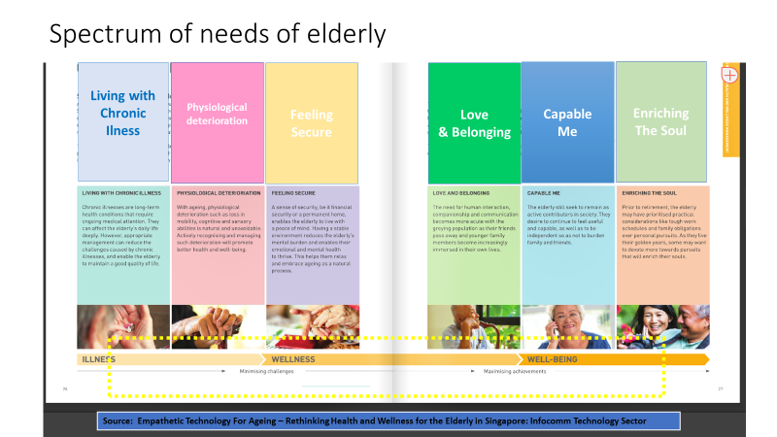
What are the experiences?
You will know the Elderly & the community resources supporting ageing
Understand the needs and characteristics of the elders and learn about the related social/community resources to support them

Slide 31
What are the experiences?
You will learn to apply skills and social work knowledge to work with different groups of the elders
the retirees
the singleton
doubleton elderly
the elderly living with different long-term illnesses e.g. Dementia; Parkinson’s Disease; Stroke; Cancer; mental illnesses – Depression and Anxiety and to work with the caregivers.
Crisis related knowledge – e.g. bereavement/ Elderly suicide / suspected Elderly abuse

Slide 32
What are the experiences?
You will expose to practice of multi-disciplinary care approach
working with other healthcare professionals such as nurse; occupational therapist; physiotherapist; dietitian; music therapist etc

Slide 33
What are the experiences?
Subvented Services
Residential Care Services
Community Care Services
Care and Attention Homes for the elderly (C&A Homes)
Nursing Homes (NH)
Enhanced Bought Place Scheme
Residential Care Service Voucher for the Elderly (RCSV)
Elderly centre services
DECC / NEC / STE / SE
Community Care Services
Day Care Centers / IHC / EHCCS
Other support services
Cases, Groups, Programs
Notes:
Residential – live in facilities for the frail elderly
Community Care – Ageing in place, still living in their own homes

Slide 34
Residential Home
Social Worker Roles:
Administration duties (admission; Regulation compliance; Handling family enquiries and feedback etc)
Social Care Groupwork, case and program
Work as a bridge between the home and the family members
Support care team to address the social care needs of the residents
Click the link to learn more about residential home services from SWD
https://www.swd.gov.hk/en/pubsvc/elderly/cat_residentcare/index.html
Target: elders who assessed to be of moderate impairment and require daily personal care and attention.
Provide residential care, meals, personal care and limited nursing care

Slide 35
Residential Homes
Mainly Mon to Fri duties
Working Hours: 9:00 am – 5:00/6:00 pm
Saturday duty is DISCOURAGED. It can only be arranged upon discussion with OIC due to a lack of support from Agency social worker on Saturdays.
Sometimes weekend duties for programs/events.
Need to fit the routines of the homes e.g. the meal times and the nap/sleeping times
Placement hours at night or on weekend is not NOT a norm due to the routine of the elderly and the work schedule of the multi-disciplinary team.
Methods of Work:
* Residential Home-Based
* Some community event
For Part-time students: Please note that it is not a norm for placement students to work in night shift. You are also recommended to stay flexible to commit work during weekdays as most of staff meetings and client social welfare services are arranged during the office hours.

Slide 36
District Elderly Community Centre (DECC) Neighbourhood Elderly Center (NEC)
A community support service to provide a range of comprehensive services to enable elderly persons to remain in the community, to lead a healthy, respectful and dignified life and to enhance their positive and contributing role to the society
Social Worker works with the elderly and the caregivers through :
Methods of Work: * CENTER –BASED : casework, groupwork, program * HOME VISIT * COMMUNITY OUTREACH
Click the link before to learn more of the services from SWD
https://www.swd.gov.hk/en/pubsvc/elderly/cat_commsupp/elderly_centres/

Slide 37
District Elderly Community Centre (DECC) Neighbourhood Elderly Center (NEC)
Mainly Mon to Fri duties (8:30am/9 am to 5/6 pm)
Saturday duty possible upon agreement with agency
and FWS, however, with
less supervision support from social workers.
Sometimes weekend duties for programs/ events.
Casework, groupwork and program
Scope of Services:
Educational & Developmental (e.g. volunteer development)
Social Activities
Counselling
Supports for the Elderly (STE)
Caregiver Supports
Integrated Home Care Services
Enhanced Home and Community Services

Slide 38
Casework
Case management for referrals of tangible services (LTC case)
Carer Stress and Support (Needy Carers and Ordinary Carers)
Long term care due to Health issues: Dementia/Cancer/Stroke
Family relationship
Bereavement
Depression
Risk of Social Isolation

Slide 39
Groupwork
Developmental group:
Positive Aging, Volunteer training, Social relationship, GrandParenting, life and death….
Therapeutic Group:
Cognitive Stimulation; Chronic Pain, Insomnia, Depression….
Carer Support Group:
Stroke, Dementia…

Slide 40
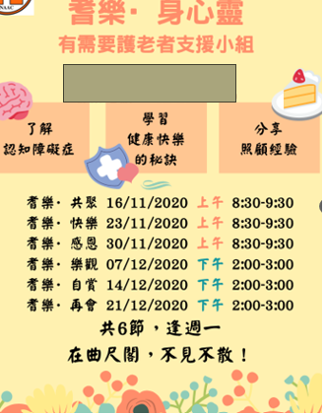
Groupwork
Needy Carer Support Group

Slide 41
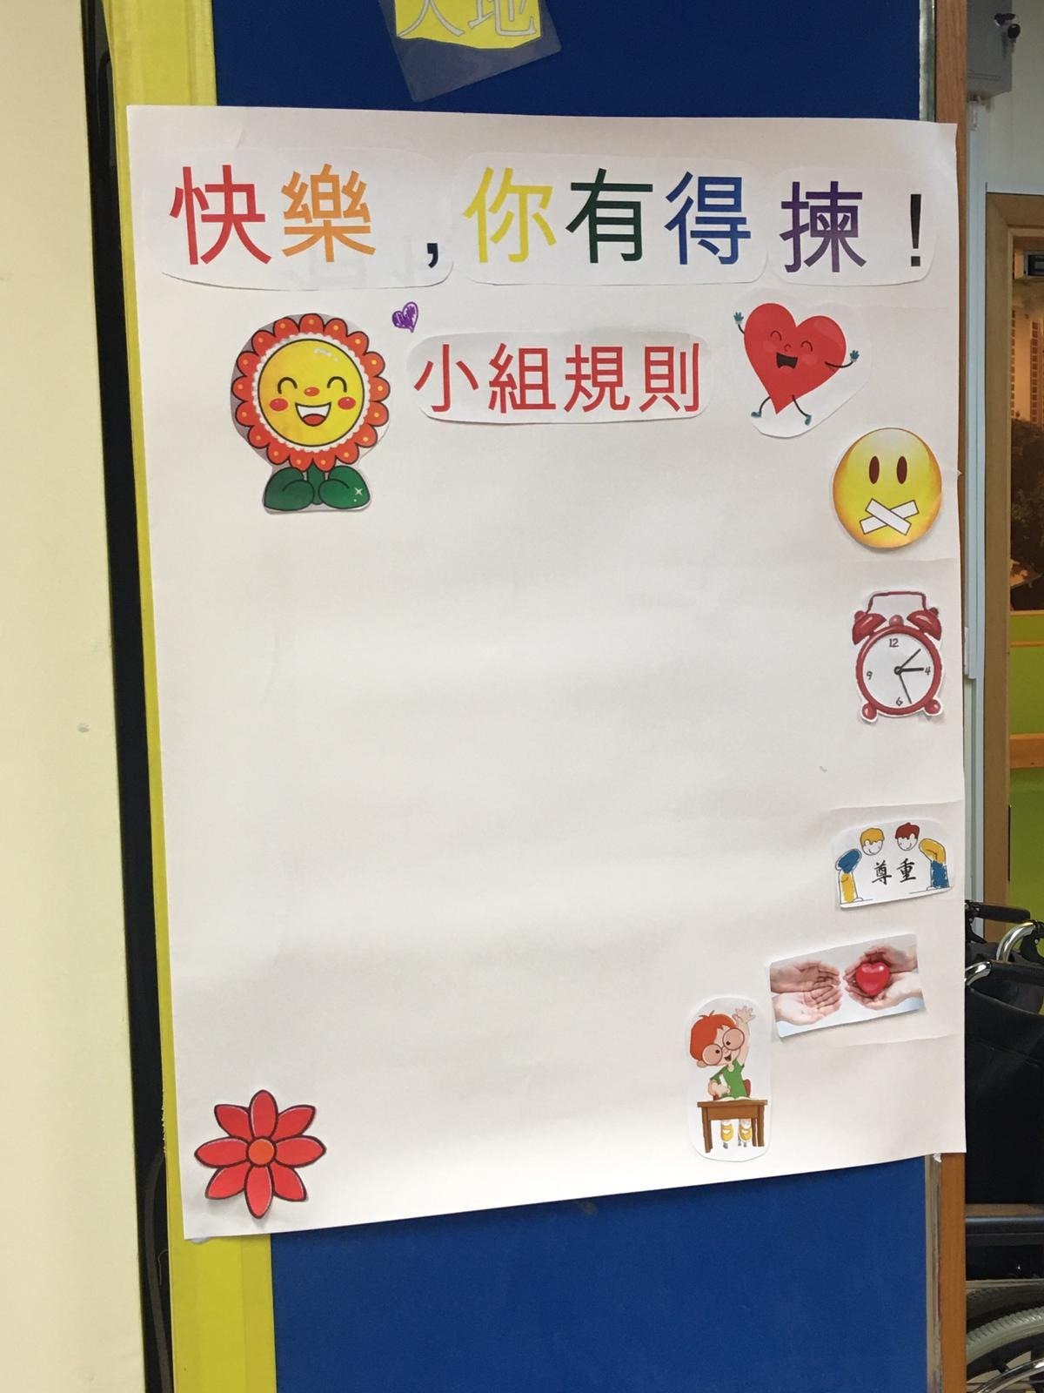

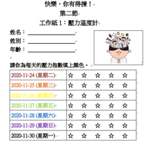
Groupwork
Psychoeducatiional mutual support group – PERMA of Positive Psychology

Slide 42
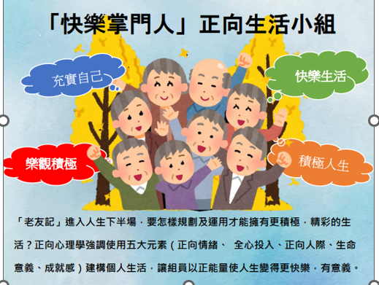
Groupwork

Slide 43
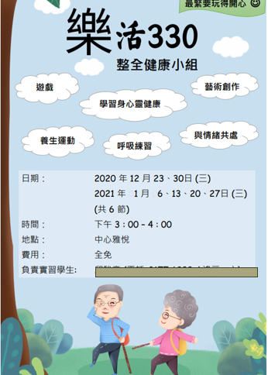
Groupwork

Slide 44
Program
Caregivers Appreciation
Festive seasons celebration
End of Life Information
Boardgame
Family Photo Day
Volunteer Service Day
Drama Theatre
Elderly Welfare Services Information
Elderly Friendly Community
Mental Health – Human Library

Slide 45

Work Skills/Knowledge
Coordination skills
Team work spirit
Multi-disciplinary cooperation
Health Issues Faced by the Elderly e.g. Dementia / Stroke
Good understanding of variety of elderly services and community resources
Knowledge about Grief and Loss; Bereavement…….

Slide 46

Attitude
Curiosity & Be Open
Self-Initiative to learn from different teams
Patient
Positive
Polite, Respect and Care
Punctuality
Self-discipline with good time and workload management
Flexible and willing to shoulder additional duties

Slide 47

Student’s Story in ES placement
Notes:
Engagement => bonding and appreciation
Elderly with frailty (walking with a stick )
Sent this poem to the center to show appreciation

Slide 48

Alex Cheung MSW-FT 1st : ICYSC 2nd : DECC
對長者服務印象完全改觀. 以前覺得長者服務好悶, 原本咁多元化
50+ 好好玩, 他們係Contributors , 有好多發揮. 當義工去解釋HEALTH REPORT 同可以帶康樂運動小組. 跟他們學到很多
醫社合作，
大開眼界

Slide 49

Sharon Law MSW-FT 1st : Rehab 2nd : DECC
好豐富嘅體驗
*50 Plus,
active ageing
基層醫療
醫社合作
好多新潮活動
＊Soft Volleyball
*Singing Bowl
*電競: 傳說對決
大學學嘅可以應用
Groupwork
Casework
Program
Casework可以做家訪； 用family perspective and system perspective 去介入。

Slide 50

Thank You !
For Enquiry:
Email : edith828@hku.hk
Office Tel: 3917 4110
Office: CJT-554
Elderly Service Setting Coordinator :
EDITH FUNG SIU HA

