Slide 1


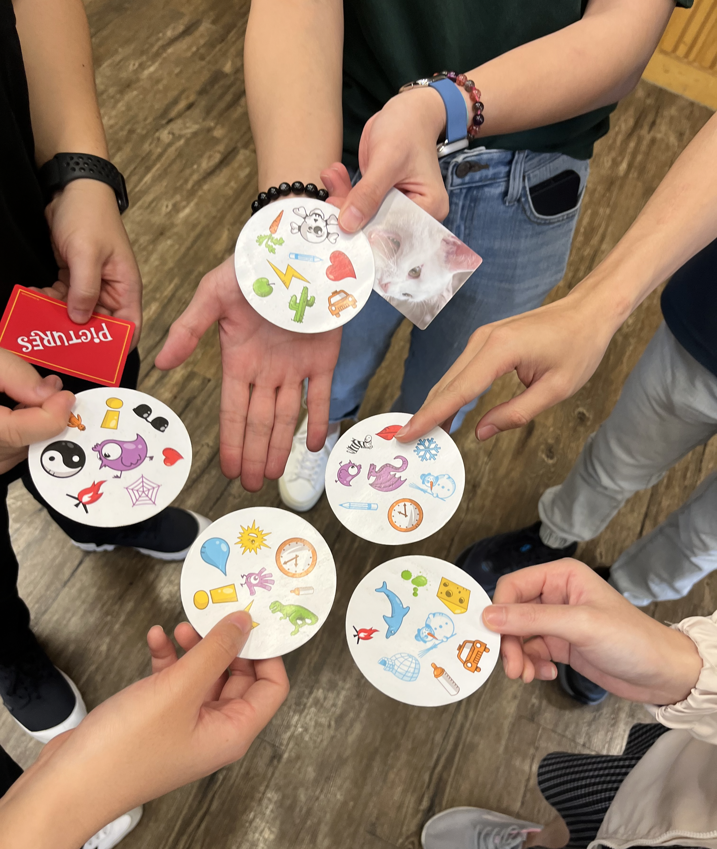
2026 – 27
Placement Briefing
Services for
Children and Youth
Ms. Jake PANG
22 Nov 2025

Slide 2


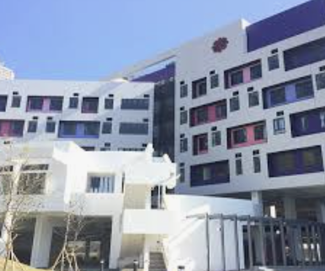
Type of Services
Centre Based
Youth At Risk
Residential Setting

Slide 3

Centre Based Services
1 | 139 Integrated Children & Youth Services Centers (ICYSC)
2 | 22 Children & Youth Centers (CYC)

Slide 4
Youth At-risk Services
1 | 19 district youth outreaching social work teams (YOTs)
2 | 18 designated ICYSCs are provided with additional manpower and funding to provide Overnight Outreaching Services for Young Night Drifters (YNDs)
3 | 5 community support service scheme (CSSSs)
4 | Service for Drug Abusers
5 | Correctional and offender Services

Slide 5
Residential Services
1 | Children’s Homes (aged 6-21), Boys/Girls Home (aged 7 -21), Hostels (aged14-21), Small group homes/ Hostel (aged 4 to 18)

Slide 6
Integrated Children & Youth Service Centers (ICYSC)
Report on the Review of Children & Youth Centre Services(1994): C&Y Centre services + outreaching social work + School Social Work Service
Target: aged 6-24 children and youth/ parents (age range: flexible)
ICYSCs have different operating hours
    A Shift: morning session (10 a.m. to 1 p.m.)
    P Shift: afternoon session (2 p.m. to 6 p.m.)
    N shift: evening session (6 p.m. to 10 p.m.).

Slide 7
Services Provided
Core programs:
1) Guidance and counseling;
2) Supportive services for young people in disadvantaged circumstances;
3) Developmental and socialization programs;
4) Community engagement programs
Non-core programs (drop-in service, interest groups, overnight camp, summer youth program and/or study/reading room service)

Slide 8
Learning opportunities
Mainly Group work (e.g. volunteer training, social skills training), workshops and mass program (camps and adventured-based activities, community engagement programme)
Working with different stakeholder and/or outside organizations (e.g.: Schools, IFSCs/ District Council etc.)
School supportive work e.g.「小學全方位輔導服務」、「成長的天空」、「共創成長路」、「區本及校本課後支援計劃」
IDP (new) Individual Development Plan, using ”casework” approach and packaged by “programme” to help young service users under continuous review

Slide 9
Things to Note
Casework (IDP/ informal case) requests special liaison with FWS
Irregular working hours (am, pm & evening sessions, occasionally weekend and holidays)
Include many school support services
Be very proactive to recruit group members
Not easy to engage adolescents, mainly are children (at after school programme)
High chance working with SEN children, new arrivals and/or low-income families

Slide 10
Residential Services
Non-institutional Care
1) Ordinary Small Group Home: (4 to 18 years old)
  - for those needy families who could not take care of their children temporary, just like a home-like environment for the children until they can return to their families or a long-term alternative living arrangement is achieved
2) Integrated Small Group Home
7 children with ages of 4 to 18 and 1 mildly mentally handicapped child with ages of 6 to 18
Institutional Care
  1) Boys' / girls' homes
  - for children or young persons aged 7 and under 21 with behavioral or emotional problems.
  2) Boys’/ girls hostels
  - for young persons between 14 and under 21 years of age who are studying or working

Slide 11
Learning Opportunities
Engagement skills;
Trust and attachment
Daily operation in structured setting
Case, group, programs
Inter-disciplinary cooperation (such as: nurses, childcare workers, teachers);

Slide 12
Things to Note
Working hours covers 3 shifts, depending on agency’s requirement; be prepared to work take up night shifts until 10p.m. to engage clients who return from school or work
High sensitivity to protect client’s privacy
Clients usually develop strong attachment with student worker, be prepared for good termination
Get ready to deal with SEN related behavioural problems

Slide 13
Services for Youth-at-risk
District Youth Outreaching Social Work Service (YOTs)
Overnight Outreaching Service for Young Night Drifters (YNDs)
Community Support Service Scheme (CSSSs)
Service for Drug Abusers
Correctional and Offender Services (Not availiable this year, sorry!)

Slide 14
Outreaching Services (YOTs)
Target: 6-24 youth-at-risk
Reach out to individuals and groups who use to hang around in public premises;
Spot Works: possible working spots to engage users at football pitches, parks, game centers, fast food shops, street corners, shopping malls… all are unstructured sites.
Common issues: drug abuse, triad society, truancy, sex-related issues, crime, emotional disturbances, family issues
Irregular working hours and outdoor work
Usually between 10a.m. to 10p.m. (No overnight outreaching placement)
Night shift is common (6p.m. onwards till 10p.m.)
Casework, groupwork, mass program

Slide 15
Things to Note
Acceptance and confidence in handling their testing behaviors and misbehaviors;
Icebreaking & engagement skills are crucial; not afraid of being rejected
Independent, mature, initiative, creativity, interest in working with these youngsters;
Understanding natural group and gang dynamics;
Very challenging and with frequent frustration, especially related with value and ethics

Slide 16
Community Support Service Scheme (CSSS)
Community Support Service Scheme (CSSS) aims at helping children and youth cautioned under the Police Superintendent‘s Discretion Scheme (警司警誡令) with a view to re-integrating them into the mainstream education or work force and reducing the likelihood of re-offending.
Five CSSSs are attached to 5 ICYSCs
Irregular working hours, sometimes need to accompany clients to Court or Police answering bail

Slide 17
Services Provided
Casework
1) Guidance and counseling;
2) Supportive services for arrested youth and their families
3) Noted that client can deny service once the Police Discretion is given
Programmes e.g. Day camp, volunteer services, community education program with HKPF, education talk
Group is arranged only on need based, e.g. sex offenders group, anger management group

Slide 18
Things to Note
Primary clients are youngsters under Police Superintendent's Discretion; some clients are consented to receive service right after their arrest (i.e. Arrested Youth) and they can also refer their peers for service
Clients may also refer “Peers Case”
The continuity of case intervention is unpredictable
Sensitive to multi disciplinary co-operation e.g. work culture of HKPF
Very challenging and with frequent frustration, especially related with value and ethics
Very ad hoc calls or work on public holiday

Slide 19
Services for Drug Abusers
Voluntary Residential Treatment and Rehabilitation Services (e.g. Hong Kong Christian Service Jockey Club Lodge of Rising Sun)
Counselling Centers for Psychotropic Substances Abusers (e.g. TWHGs CROSS Centre, PS33)
It aims at providing counselling and assistance to habitual/occasional/potential psychotropic substance abusers and to young people at risk with a view to assisting them to abstain from psychotropic substance abuse and develop healthy life style.
case and group counselling for psychotropic substance abusers;
counselling for their family members;
regular preventive education programs/talks for secondary students and the community

Slide 20
Things to Note
Mainly deal with unmotivated and involuntary clients (CSSSs, drug abusers…)
Be familiar with the drugs effect and medical model on treatment
Be initiative, good engagement skills
Special talents to attract the youths to talk to you

Slide 21
Correctional & Young Offender Services
Secondary setting, service provided by Correctional Department, institutes usually located at remote areas.
Dealing with clients who have committed criminal offences, clients’ family support work may not be possible.
Not open for summer placement

Slide 22
Things to Note
Pre-placement security vetting will be conducted by CSD which usually take time
Working hours start from 8am to 5:30pm at restricted working conditions, with rare outside duties. E.g. when working inside the office, all personal mobiles or private computers need to be kept at the visitors’ lockers. Internet service is limited within the work setting.
Need to follow strict security requirement e.g. security check at every main-gate area, no mobile phone or internet services
Require to be familiar with the rules and regulations of each institute.
When performing case interviewing or group sessions or projects, additional staff would be placed in the room for security reason.
Placement supervisor may have limited on-site supervisions to placement students owing to the security reason, therefore, additional supervision meetings need to be arranged at HKU on non-placement days.

Slide 23
https://placement.socialwork.hku.hk/placement.html
Placement form:
A-09 Agency Feedback Form [Agency expectation]
A-10a Assessment of performance [FWS Expectation]
Increment weather arrangement and Safety measures For contingency, well prepared for summer outings/ camps or any outdoor activities, agency may have specific guidelines
How to prepare your placement?

Slide 24
AI generated language models
In order to maintain client’ confidential data and in line with the ethical practice of the profession and the requirements of the Personal Data (Privacy) Ordinance, 1995, which are reiterated in the social work fieldwork placement handbook (pp.16), it is prohibited to use the Al generated language models for fieldwork courses.
Remark: Use of Grammarly is acceptable for fieldwork courses

Slide 25
Contemporary approaches to work with young people
Expressive Art
Positive Psychology
Narrative Therapy
Mindfulness
Career guidance
Use of Play
Newly emerged sports
Adventure Based Counselling
Self-understanding tools
Employment support
Strength based approach

Slide 26

Latest trend
HKJC Youth Projects:
21C@JC
LevelMind
Project Bonfire
Youth Development Blue-Print
YDC Youth Ambassadors Programme

Slide 27
Highlights of placement choices
Outreaching – Playground YTM district
CSSS – BGCA Kowloon West
Residential – SA Wan Tsui Boy Home
Centre/ School - Centre of Restoration of Human Relationships
ICYSC – Caritas Shek Tong Tsui

Slide 28
Useful websites
http://www.swd.gov.hk
https://www.youthblueprint.gov.hk
http://www.hkfyg.org.hk
http://www.bgca.org.hk
http://hkcs.org/gcb/ps33
https://www.salvationarmy.org.hk/
https://hksas.org.hk
https://www.sbc.org.hk/service-units/sbcstc
https://csss.hkpa.hk
https://www.csd.gov.hk
https://www.chsc.hk

Slide 29
Reference
Atkin, S., Noller, P. (2014). Family life in adolescence. Warsaw/Berlin: De Gruyter Open Ltd.
Au Liu, Elaine S.C., Holosko, Michael J., & Lo, T. Wing. (2009). Youth empowerment and volunteerism: principles, policies and practices. Hong Kong: City University of Hong Kong Press.
Burns, Barbara J. & Kimberly Hoagwood. (2002). Community treatment for youth: evidence-based interventions for severe emotional and behavioral disorders. New York: Oxford University Press.
Diaz, C. (2020). Decision Making in Child and Family Social Work: Perspectives on Children’s Participation (1st ed.). Policy Press. https://doi.org/10.2307/j.ctv12sdx4b
Dimitrova, R., & Wiium, N. (Eds.). (2021). Handbook of positive youth development : advancing research, policy, and practice in global contexts. Springer. https://doi.org/10.1007/978-3-030-70262-5
Fox, Darrell., & Arnull, Elaine. (2013). Social work in the youth justice system a multidisciplinary perspective. Open University Press.
Gibson, K. (2011). Street Kids: Homeless Youth, Outreach, and Policing New Yorks Streets (1st ed.). NYU Press. https://doi.org/10.18574/9780814733370
Geldard, K. (Ed.) (2009). Practical Interventions for young people at risk. London: Sage Publications.
Healey, J. (2017). Children and Young People at Risk (1st ed., Vol. 322). Spinney Press, The.
Lee, F. W. (2010). Nurturing Pillars of Society: Understanding and Working with the Young Generation in Hong Kong (1st ed.). Hong Kong University Press, HKU.
Watkins, C. S. (2009). The young & the digital: what the migration to social-network sites, games, and anytime, anywhere media means for our future. Boston: Beacon Press.

